Slide 1
PL-8000T System Requirements Rev 2.5
July 2025

Slide 2
Change log
Rev 2.0 25 March 2024 – Preliminary version
Rev 2.1 30 April 2024 – Cumulative update
Rev 2.2 03 November 2024 – Lambda split option added. Uplinks CFP2 are replaced by OSFP
Rev 2.3 25 June 2025 – Uplink replaced to QSFP-DD, Cumulative update
Rev 2.4 15 July 2025 – Ports reordered, Ring
Rev 2.5 30 November 2025 – Provisioning , Updated Ring (TBD TBD)

Slide 3
Agenda
Motivation
Standards and references
Hardware description
General System Requirements
META-DX2+
Service Provisioning
Management Requirements (MIBS, GUI, etc)
Configuration
PM
Fault
Path Delay
Diagnostics
Protection Requirements (Ring (TBD), Facility, Equipment)
Additional requirements
Lambda split
Inband over GCC/FCC (TBD. Depend of optics)
Encryption MACSec (TBD)
Open Issues

Slide 4
Motivation & Highlights
Up to 3.2T in a 1U box by four DWDM wavelengths of 800G
Uplink optic is 800G QSFP-DD/ 400G QSFP-DD ULH with Lambda Splitting
Support for 4x800GE, 8x400GE or 32x100GE services or MIX
Support up to 8 PL-4000M (8x 4xFOIC1.2)
Support Ring, Facility, Equipment protection
Major features:
MACSec Encryption (TBD)
Inband (OHIO)
LLDP
Idle Insertion
Facility, Equipment and Ring protection
Integrated solution with the EDFAs, MUX/DEMUX and OSW/OLP

Slide 5
Standards and references
# | Document | Comments
1 | G.709, Amendment 3 (NEW) | Interfaces for the optical transport network. Approved in March 2024
2 | G.709.1, Amendment 2, G.Sup58 G.709.5 (NEW) | Flexible OTN short-reach interfaces. Optical transport network module framer interfaces FlexO-1/2/4 FlexO-8. Approved in March 2024
3 | IEEE 802.3 IEEE P802.3df Draft ETC 800G Specifications | IEEE P802.3df™ Draft Standard for Ethernet Amendment: MAC Parameters for 800 Gb/s and Physical Layers and Management Parameters for 400 Gb/s and 800 Gb/s Operation
4 | META-DX2+ Datasheet, Software manual, Errata | Revision C. Updated Nov 2024
5 | Acacia QSFPDD-DCO Product Specification | C9 QSFP-DD Digital Coherent Pluggable Module Advanced Product Specifications. 075-0292-00. 3/4/2025
6 | MSA CMIS | Common Management Interface Specification (CMIS) Revision 5.3

Slide 6
PL-8000T Hardware Description

Slide 7


PL-8000T Mechanics Front view
Basic variant
Lambda split variant (TBD)

Slide 8
PL-8000T Ports
MPO
CLI
ALM
MPO
C1
C2
U1
U2
C3
C4
C5
C6
U3
U4
C7
C8
MNG1
MNG2
LAN1
LAN2
USB1
USB2
MPO
LC
CLI
ALM
LC
C1
C2
U1
U2
C3
C4
C5
C6
U3
U4
C7
C8
MNG1
MNG2
LAN1
LAN2
USB1
USB2
4x Uplink Ports:
U1-U4 : 4xQSFPDD-DCO
8x Clients Ports:
C1-C8 QSFP-DD
2x MPO (The upper MPO is connected to the 4D OSW (OLP); The lower MPO is connected to the splitter box (SPLT))
1xMPO + Quad LC + Dual LC (MPO: Gathers 8x Uplinks + OSC) - Optional for Lambda Split mode*
8x Management ports
2x SFP: MNG1 and MNG2
3x RJ45 for LAN1, LAN2 and CLI for local Management
RJ45 for External Alarms
2x USB 3.0 Type-C CLI for local Management and Memory Stick connection
* - See comment

Slide 9
PL-8000T LEDs
LEDs:
PWR
4 x Uplink ports
8 x 800G/400G ports
2x MNG: MNG1 and MNG2
EDFA1/COM1 and EDFA2/COM2
3x System: Critical/Major/Minor
FAN
2x USB

Slide 10
General Requirements
Two slices of 1.6T
A single 1.6T slice may serve the following clients:
Any mix of up 2x800GE, 4x400GE and 16x 100GE (breakout cables)
8x 4x FOIC1.2 (for 8x PL-4000M)
Demarcation functions:
Faults - Clients and uplinks
PM – Clients and uplinks
Diagnostics and maintains
MACSec GCM AES-256 Encryption (TDB)
Inband management channel
LLDP snooping
Idle insertion
Path Delay Measurement (Optional. Depend on optics)
Lambda split
Protection types: 800G ring for each slide, Facility protection - Optical Switch (1:2 or 4x 1:2(OLP)), Equipment protection
LW management
CSMM
SMM (Optional in case of service provisioning)
Optional integrated 1-2 EDFA, MUX/DEMUX 2:1, Optical Switch (OSW) or OLP
Note: PL-8000T supports 800GE and 400GE client modules only. To connect 100GE clients should be used breakout cables

Slide 11
System requirements – General architecture
General Requirements:
Two slices 1.6T
Each slice includes:
Uplink Optics:
2x800G (4x800G)
Client Optics per slice:
4xQSFPDD (2xQSFPDD)
PHYs:
META-DX2+
Services per slice:
Up 2x 800GE
Up 4x 400GE
Up 16x 100GE (breakout cable)
Mix of the above
Up 4x 4xFOIC1.2
Support 2x800GE rings
Lambda split 2x800G -> 4x 400G
Future support MACSec encryption per Service

Slide 12
Client’s DAC connectivity
For inter PL-8000T should provide DAC-cables connectivity instead client optic modules
DAC
Ethernet Switch
Ethernet Switch
Ethernet Switch
Ethernet Switch
DAC cable types:
800G QSFP-DD to QSFP-DD
400G QSFP-DD to QSFP-DD (for Ethernet or FOIC)
4x100G QSFP28 to QSFP-DD

Slide 13
META-DX2+

Slide 14
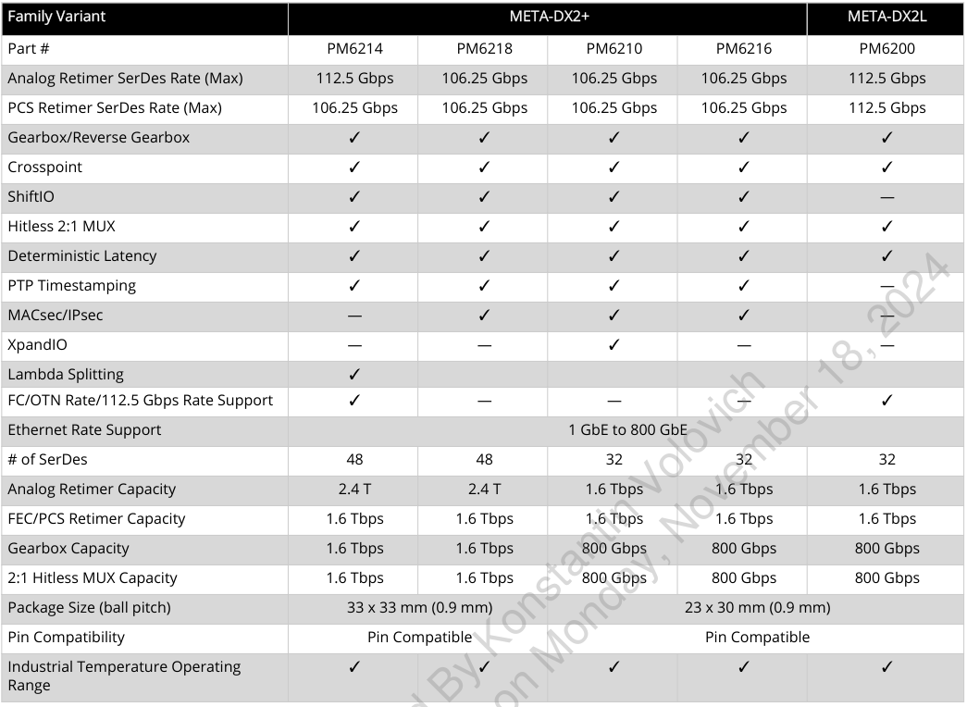
META-DX2+ PM6214 or PM6218
For encryption’s possibilities shall choose
PM6218 model
For Lambda Split and FOIC possibilities
shall choose PM6214 model

Slide 15
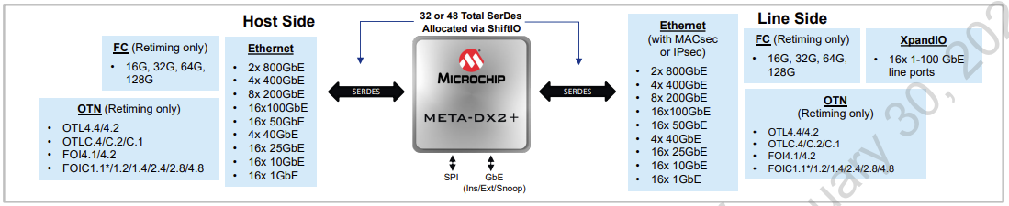
META-DX2+ General Information
META-DX2+ integrates 32 or 48 high-speed multi-rate SerDes capable of supporting data rates from 1.25 Gbps (NRZ) to 112 Gbps (PAM4) per lane. The number of SerDes lanes assigned to the Host and Line sides of the device can vary depending on the configuration of the ShiftIO feature which allows one octal bank of SerDes to be reallocated to either side of the device or two octal banks to be reallocated to the Line side.
Client
Uplink
PL-8000T shall use META-DX2+ for:
Gearboxing of the 25G NRZ and 50G PAM4 Ethernet client lanes to/from CFP2-DCO 100G PAM4 lanes
Cross connection – required to compensate PCB cross connections
Client Facility Loopback
Lambda splitting
Gearboxing of the 56 PAM4 FOIC1.2 client lanes to/from QSFPDD-DCO 112G PAM4 lanes (FOIC1.1)

Slide 16
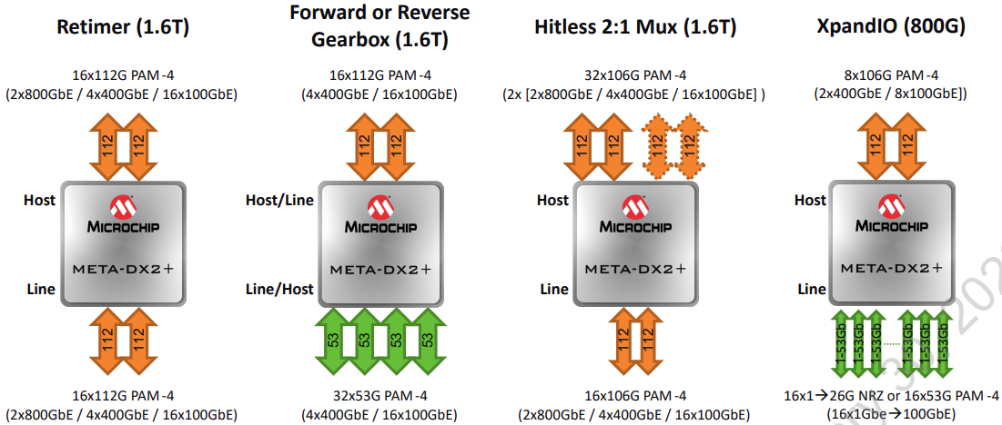
META-DX2+ Main features
Retimer: Supports up to 16 Host + 16 Line SerDes for 32 SerDes variant and 24 Host + 24 Line SerDes for 48 SerDes variant.
Forward and Reverse Gearbox: Octal Banks of SerDes are reallocated with ShiftIO allowing for a higher SerDes count facing the Host or Line side of the META-DX2+. Enables 1.6Tbps forward or reverse gearbox applications with Analog/PCS/FEC/MAC datapaths. Gearbox applications are support with only SerDes bit multiplexing or full PCS layer termination/regeneration.
2:1 Hitless Multiplexer: Octal Banks of SerDes are reallocated with ShiftIO allowing for a higher SerDes count facing the Host side of the META-DX2+ with up to 3.2T of Host side ports and Ethernet PCS/FEC monitoring. Multiplexes one of two Host side interfaces (working vs protect) to the Line side hitlessly while broadcasting the Line side port to both the Working and Protect Host side ports.
The Crosspoint 2:1 Multiplexer datapath provides 2:1 MUX and 1:2 broadcast functionality for Analog Retimer, PCS Retimer and MAC datapaths. The datapath can be supported in both directions of the device with Working and Protection ports supported on either the Host or Line side.

Slide 17
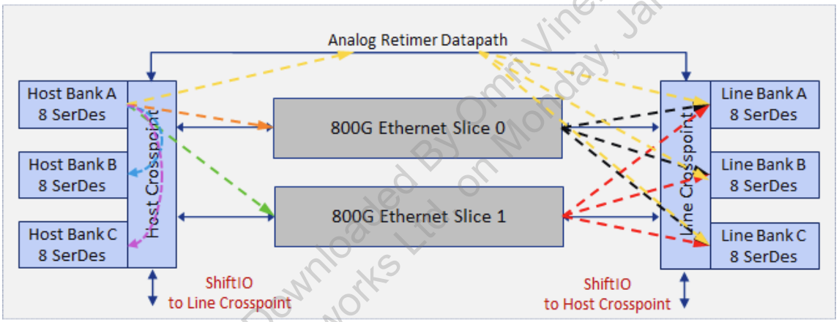
META-DX2+ Crosspoint
Crosspoint connectivity
Host Crosspoint connects any Host side SerDes bank to either 800G Ethernet slice or the Analog Retimer datapath
Line Crosspoint connects any Line side SerDes bank to either 800G Ethernet slice or the Analog Retimer datapath
Within each SerDes bank, any-to-any lane swapping is supported. Multi-lane interfaces can use any Serdes within a bank, but cannot span across two banks
When using the analog retimer datapath, SerDes connections are any-to-any for Host<->Line connections
Same Side Connectivity (Bank to Bank on the Line side ONLY)
Each crosspoint supports connection from one bank to other banks on the same side of the device using an analog retimer datapath (Line Same Side Connectivity Analog Paths shown in blue and purple below.
Client
Uplink

Slide 18
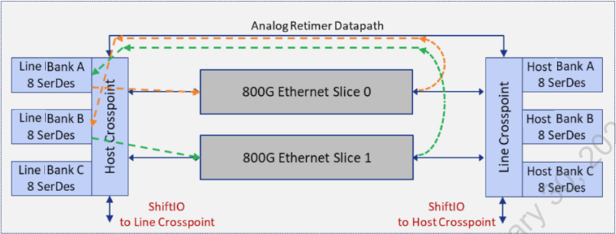
META-DX2+ Crosspoint Same Side Connectivity
META-DX2+ supports Same Side Connectivity, which is a configuration where a bank is connected through an Ethernet Slice and then through the analog retimer datapath back to any bank on the same side of the device (that is, HA to HB or LA to LC). The connectivity from crosspoint to the Ethernet Slices are unidirectional in this configuration
PL-8000T shall not use this connectivity. May be implemented in case of excess errors threshold in analog bypass. See below.
Uplink
Client

Slide 19
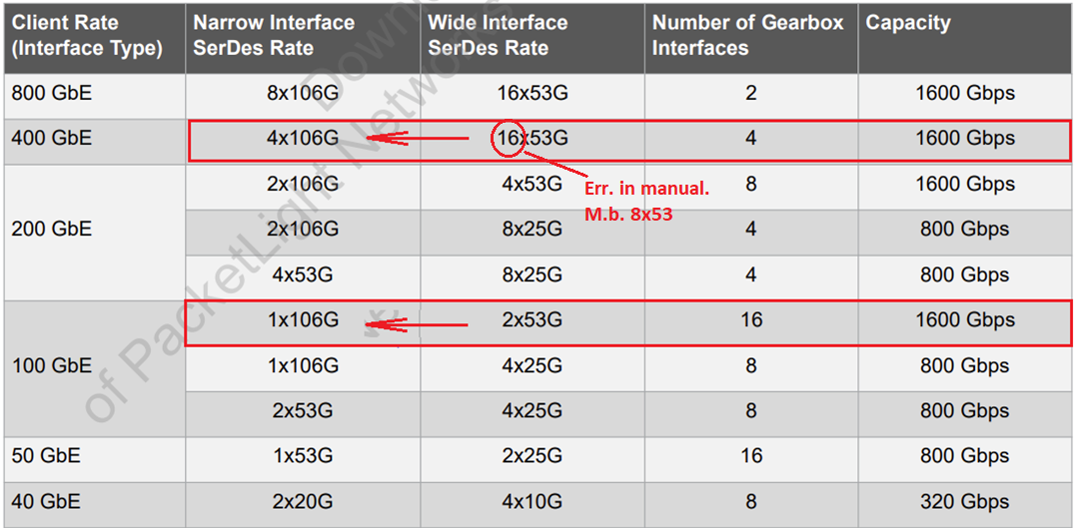
META-DX2+ Gearboxing
The META-DX2+ provides forward/reverse gearbox functionality with up to 1.6 Tbps capacity, and can gearbox in 1:2 and 1:4 ratios between the Host and Line.
The following table lists the META-DX2+ 48 SerDes device variant capacities for Ethernet forward/reverse gearbox applications leveraging ShiftIO is some cases. The forward/reverse gearbox function converts between two same rate Ethernet interfaces that each use a different lane count. Forward gearbox functions perform a wide-to-narrow (Host-to-Line side) conversion, for example, to 100GAUI-2 interface to 100GAUI-1 interface. Reverse gearbox functions perform a narrow-to-wide (Host-to-Line side) conversion, for example, 100GAUI-2 interface to CAUI-4 interface.
It's needed to use the PCS retimer & gearbox. It allows to recalculate FEC (e.g. KR -> KP).

Slide 20
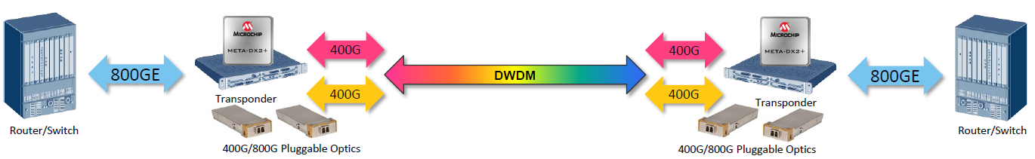
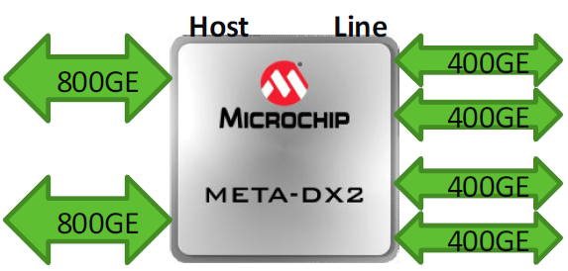
META-DX2+ Lambda splitting
Splitting large Ethernet clients across multiple wavelengths is an efficient way for long haul
Host Side Ethernet Interfaces (Clients) are split over lower rate Line Side Ethernet Interfaces (Transport PHYs)
Supported Lambda Splitting Configurations:
Host Side 800GE (IEEE/ETC) <- -> Line Side 2x400GE (IEEE compliant)
Host Side 800GE (IEEE/ETC) <- -> Line Side 8x100GE (IEEE compliant)
Host Side 400GE (IEEE) <- -> Line Side 4x100GE (IEEE compliant)
800G Ethernet
400G LH Uplink
400G LH Uplink
800G Ethernet
400G LH Uplink
400G LH Uplink
Lambda Splitting is implemented in META-DX2+ Rev. C and above, SDK 3.6.0 and above

Slide 21
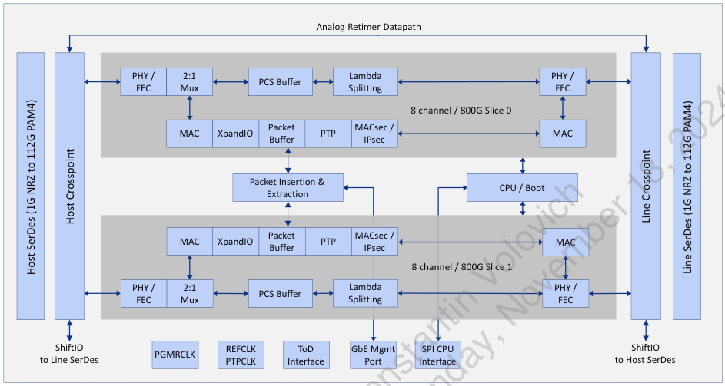
Datapath Types
Uplink
Client
Datapath types:
PCS retimer & gearbox for Lambda Split
SERDES only for analog retimer FOIC and Ring application
MAC
Notes:
Analog retimer Datapath doesn’t support FEC correction
Shall use the PCS retimer & gearbox datapath for Lambda Splitting
Shall use the MAC for MACSec encryption.
The default configuration of PCS datapaths is one where the transmit interface's PCS/FEC layer is dependent on the datapath’s
receive interface PCS Link Status. This results in the transmit interface triggering a link flap, intermittent PCS Link Status of Link-Down at the remote node, following a PCS Link Status transition of Link-Down to Link-UP on the datapath's receive interface. Following a transition to and during a PCS Link Status of Link-Down on the receive interface, the transmit interface will not trigger a link flap. During this state the PCS datapath is provisioned to insert Local Fault (LF), Remote Fault (RF) or IDLE.
In PL-8000T Local Fault (LF), Remote Fault (RF) or IDLE are inserted by CFP2-DCO. META-DX transmits these blocks transparently.

Slide 22
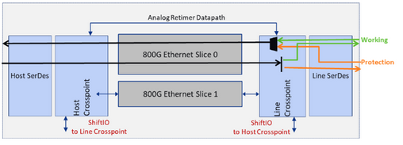
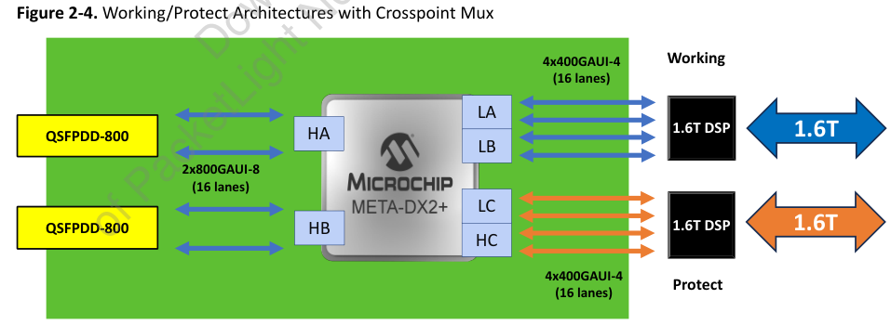
Protection. Crosspoint 2:1 MUX
Client
Uplink
In this case, the uplink work and protect ports would need to be connected to the lineside interface and client ports on the host side interface. The mux and broadcast functions are implemented at the lineside crosspoint, reducing the number of datapaths through the slices.
Interrupts from Uplink or META-DX are events for switching.
Switching is performed only by calling API function
Switching time has to be less than 50 ms
22

Slide 23
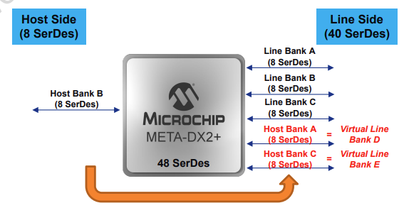
Relocation SerDes banks from Host to Line side and vise versa
META-DX2+ supports flexible connectivity of SerDes banks allocated to the Host side or to the Line side. This flexible. I/O feature (called ShiftIO) allows the crosspoint to SerDes bank connections to be customized to the application,enabling support for additional optics, or allowing more bandwidth for applications like gearboxing that require more

Slide 24
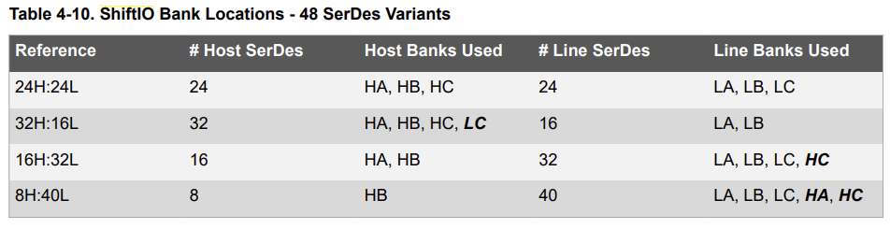
Basic configuration: 4 client ports -> 2 uplink port
PL-8000T shall use 32H:16L configuration

Slide 25
Lambda split configuration: 2 client ports -> 4 uplink port
PL-8000T shall use 16H:32L configuration

Slide 26
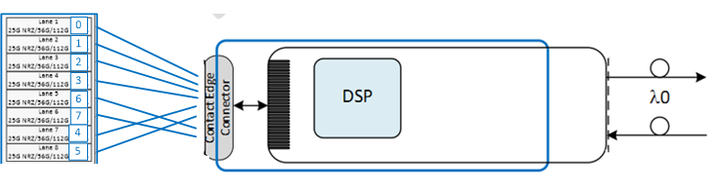
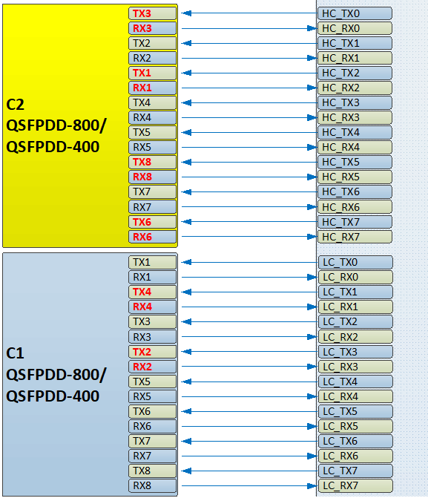
Need to be able to reorder host SerDes according with the PCB design
Each SerDes bank provides lane swapping capabilities such that the eight SerDes lanes within the octal boundary of each SerDes bank can be swapped and reordered internal to the bank without constraints. Interface allocation to device SerDes banks must follow these rules:
Single lane interfaces can be connected on any SerDes lane within a bank
Dual lane interfaces must be connected on any two SerDes lanes within the same bank. Dual lane interfaces cannot be connected across two banks.
Quad lane Ethernet interfaces must be connected on any four SerDes lanes within the same bank. Quad lane interfaces cannot be connected across two banks.
Octal lane Ethernet interfaces must be connected on all eight SerDes lanes within the same bank. – Octal lane interfaces cannot be connected across two banks.
To compensate PCB layout needs to develop:
static crosspoint tables for modules QSFPDD-DCO
static crosspoint tables for client modules
Example META-DX SerDes
crosspoint for real PCB layout
Bank HC
0 <-> 2
1 <-> 1
2 <-> 0
3 <-> 3
4 <-> 4
5 <-> 7
6 <-> 6
7 <-> 5
Bank LC
0 <-> 0
1 <-> 3
2 <-> 2
3 <-> 1
4 <-> 4
5 <-> 5
6 <-> 6
7 <-> 7

Slide 27
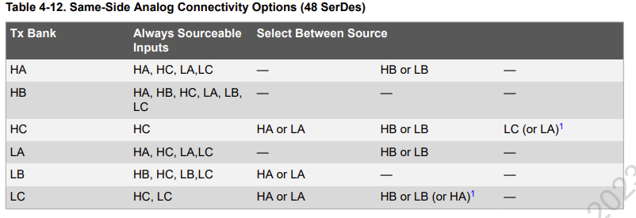
Constraints of same side connectivity
Same side analog connectivity allows for many connection combinations between banks on the same side or other side of the device. However, some banks can only source connections from specific banks. Table 4-12 summarizes the available options for the 48 SerDes devices. It is important to verify valid connectivity from a source bank to a transmit (Tx) bank in both directions, because per bank connectivity varies.
Answer of Microchip:
Same Side Connectivity (Analog Retimer Mode) is used on the LINE interfaces of META-DX2+. Switching will be supported per channel
Constraints apply ONLY to analog connectivity. PCS datapathes don’t influence to Same Side Connections
Same Side Connectivity for 800G is not implemented
For FOIC1.2 clients Analog Retimer Mode is used
There is limitations for parallel provisioning protected AddDrop and Bypass services. See below.

Slide 28
Example of service: 800G + 400G + 100G Ethernet
Client side:
1x 800GAUI-8
1x 400GAUI-8
1x 100GAUI-2 (breakout)
Uplink side:
1x 800GAUI-8
1x 400GAUI-4
1x 100GAUI-1
META-DX functions:
Gearboxing 2x53G -> 106G
PCS retiming
FEC KP4 -> KP4 No conversion, recalculation

Slide 29
Example of service: 2x 400G Ethernet + 2x 4x FOIC1.2
Client side: 4x 100GAUI-4
4x FOIC1.2
Uplink side: 4x 100GAUI-1
4x FOIC1.1
META-DX functions:
Gearboxing 4x53G -> 106G
PCS retiming (for Ethernet)
FEC KP4 -> KP4 No conversion, recalculation
Gearboxing 2x56G -> 112G
Analog retiming (for FOIC)
Notes:
FOIC client – PL-4000M
MIX Ethernet+FOIC depend on uplink. Acacia QSFPDD-DCO doesn’t support MIX mode

Slide 30
Example of service: 800G Ethernet split to 2x400G
Client side:
2x 800GAUI-8
Uplink side:
4x 400GAUI-8 or
4x 400GAUI-4 (optional)
META-DX functions:
Lambda splitting
PCS retiming
FEC KP4 -> KP4 No conversion, recalculation
Gearboxing 106G -> 2x53G optional
Note: Lambda split for FOIC doesn’t support

Slide 31
Datapath Performance Monitoring
Performance counts for a datapath might be retrieved through the API on a per-channel basis. Datapath counters are read from registers by firmware and accumulated in firmware memory in order to ensure register counters do not saturate prior to being read by the application. The firmware read and accumulate can be configured as periodic, with a frequency of 1 every second, or may be manually triggered.
MAC and PCS datapath PMONs can be retrieved using the following APIs. The accumulated counts may be optionally reset for the channel being read.
There are no PMONs for Analog retimer datapaths
Full list of PMON counters see in SDK file mdx2_pmon_types.h
PL-8000T shall use META-DX MAC and PCS PMONs for Ethernet clients.
Using of these PMONs is discussed in section “Performance monitoring”

Slide 32
Datapath Defects Monitoring
Hardware fault conditions and alarms are captured in device interrupt registers and retrieved through SDK APIs. The SDK refers to these as defects. Each individual defect is represented by a bitwise IVE (Interrupt, Value, Enable).
Firmware collects and organizes these IVEs into trees with summary nodes allowing for easier search of the entries with asserted Is or Vs.
APIs, which may be called in a polling method, or solely in response to the INTB interrupt, or a combination of both. These APIs synchronously retrieve the associated IVEs from device registers and optionally clear the asserted Interrupts.
PL-8000T shall use META-DX Defects Monitoring for Ethernet clients. FOIC clients have to be monitored by optics
Using of these META-DX faults are clarified in section “Faults”

Slide 33
Loopbacks
PL-8000T implements 3 loopbacks:
Client Loopbacks
Facility loopback loop datapath on client side META-DX
Terminal loopback loop datapath on line side META-DX
Uplink Loopback
Facility loopback loop datapath on line side of Uplink

Slide 34
Loopbacks. META-DX implementation
META-DX2+ supports a variety of loopbacks to support both system debugging and field diagnostics. The following loopbacks are supported at each of the SerDes:
Facility Loopback - Allows for the looping back of an RX interface to the TX interface in the PMA layer (Local side)
Diagnostic Loopback - Allows for the looping back of an TX interface to the RX interface in the PMA layer at the far end of the META-DX2+ datapath. The loopback is functional over all networking timing conditions and with lane swapping. This loopback is supported by default as loop and continue (Far side)
IEEE PCS loopback - Allows for the looping back of the MAC TX output to the MAC RX input within each Slice and in each direction. This loopback is supported by default as loop and continue.
PL-8000T uses:
facility loopback on the Client side to implement Client Facility Loopback
facility loopback on the Uplink side to implement Client Terminal Loopback
Client
Uplink
Uplink
34
34

Slide 35
Facility and Terminal Loopbacks on META-DX and Uplink
Client
Uplink
META-DX2+ Loopback
For diagnostic shall implemented: Client Facility Loopback
Client Terminal loopback
OSFP-DCO Loopbacks
For diagnostic purposes shall implemented:
Line Facility loopback
For debug proposes may use additional loopbacks on (Optional)
35

Slide 36
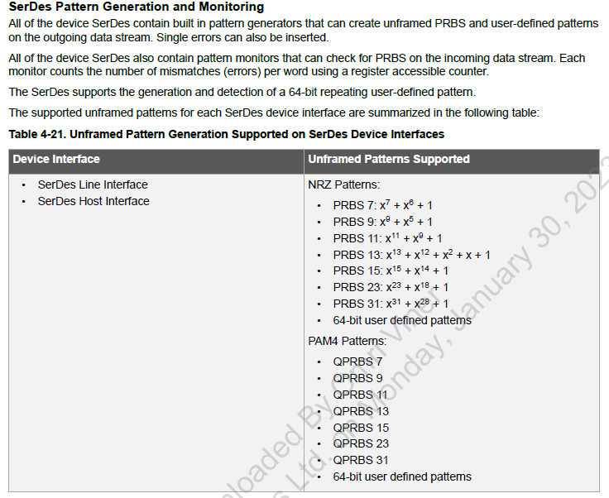
Pseudo Random Bit Sequence (PRSB)
META-DX2+ supports a variety of PRBS outgoing data streams.
PRBS 31 and QPRBS 31 should be used
Generation output PRBS for Ethernet 100G/400G/800G channels
Checking input PRBS
Counting PRBS errors
No PRBS for Uplinks

Slide 37
Service provisioning

Slide 38
Port enumeration
Slot | 800 | 400 | 100 | 800G Srv | 400G Srv | 100G Srv
P1 | 1 | 1,5 | 1,2,3,4,5,6,7,8 | 1-1 | 1-1, 1-2 | 1-1, 1-2, 1-3, 1-4, 1-5, 1-6, 1-7, 1-8
P2 | 9* | 9 | 9,10,11,12 | 2-1* | 2-1 | 2-1, 2-2, 2-3, 2-4
P3 | 13 | 13,17 | 13,14,15,16,17,18,19,20 | 3-1 | 3-1, 3-2 | 3-1, 3-2, 3-3, 3-4, 3-5, 3-6, 3-7, 3-8
P4 |  | 21 | 21,22,23,24 |  | 4-1 | 4-1, 4-2, 4-3, 4-4
P5 | 25 | 25,29 | 25,26,27,28,29,30,31,32 | 5-1 | 5-1, 5-2 | 5-1, 5-2, 5-3, 5-4, 5-5, 5-6, 5-7, 5-8
P6 | 33* | 33 | 33,34,35,36 | 6-1* | 6-1 | 6-1, 6-2, 6-3, 6-4
P7 | 37 | 37,41 | 37,38,39,40,41,42,43,44 | 7-1 | 7-1, 7-2 | 7-1, 7-2, 7-3, 7-4, 7-5, 7-6, 7-7, 7-8
P8 |  | 45 | 45,46,47,48 |  | 8-1 | 8-1, 8-2, 8-3, 8-4
Internal port
numbers
Port numbers for customer
* - for Lambda Split mode only

Slide 39
System modes
PL-8000T may be configured to support independent service configuration for each uplink, ring support and lambda splitting. System mode is the same for both slices of device.
System mode | Provisioning
Simple services | Service may be provisioned to any uplink if it is supported by current Mix of services
Ring protection | Unprotected service may be provisioned for any uplink, protected service have to be provisioned for both uplinks
Lambda splitting | Static provisioning

Slide 40
System mode: Simple services
Mix of Services is configured for each Uplink independently
 | Mix of Services | Ports modes (Uplink #1) | Ports modes (Uplink #2) | Ports modes (Uplink #3) | Ports modes (Uplink #4) | MIB xpdrMixOfServices | MIB XpdrServiceType (clients)
1 | 800GbE | Port: P1 800Gbe-LAN | Port: P3 800Gbe-LAN | Port: P5 800Gbe-LAN | Port: P7 800Gbe-LAN | mix1x800GBE | gbe800lan
2 | 2x400GbE | Ports: P1,P2 400Gbe-LAN | Ports: P3,P4 400Gbe-LAN | Ports: P5,P6 400Gbe-LAN | Ports: P7,P8 400Gbe-LAN | mix2x400GBE | eth1x400G
3 | 2x400GbE (breakout) | Ports: P1 400Gbe-LAN (breakout) | Ports: P3 400Gbe-LAN (breakout) | Ports: P5 400Gbe-LAN (breakout) | Ports: P7 400Gbe-LAN (breakout) | mix2x400GBEbreak (NEW) | eth1x400G
4 | 400GbE+4x100GbE (breakout) | Port: P1 400Gbe-LAN Ports: P2 100Gbe-LAN (breakout) | Port: P3 400Gbe-LAN Ports: P4 100Gbe-LAN (breakout) | Port: P5 400Gbe-LAN Ports: P6 100Gbe-LAN (breakout) | Port: P7 400Gbe-LAN Ports: P8 100Gbe-LAN (breakout) | mix1x400GBEand4x100GBEbreak | eth1x400G gbe100lan
5 | 8x100GbE (breakout) | Ports: P1 100Gbe-LAN (breakout) | Ports: P3 100Gbe-LAN (breakout) | Ports: P5 100Gbe-LAN (breakout) | Ports: P7 100Gbe-LAN (breakout) | mix8x100GBE | gbe100lan
6 | 4x100GbE+4x100GbE (breakout) | Ports: P1,P2 100Gbe-LAN (breakout) | Ports: P3,P4 100Gbe-LAN (breakout) | Ports: P5,P6 100Gbe-LAN (breakout) | Port: P7,P8 100Gbe-LAN (breakout) | mix2x4x100GBEbreak (NEW) | gbe100lan
7 | 2x400G FlexO | Ports: P1,P2 400G FlexO | Ports: P3,P4 400G FlexO | Ports: P5,P6 400G FlexO | Ports: P7,P8 400G FlexO | mix2x400FOIC11 | flexo4x100G
TBD: System mode defines ether Basic operation or Lambda Splitting
40

Slide 41
Static Service Combinations (System mode TBD: Basic operation)
Mix of Services is configured for each Uplink independently
 | Mix of Services | Ports modes (Uplink #1) | Ports modes (Uplink #2) | Ports modes (Uplink #3) | Ports modes (Uplink #4) | MIB xpdrMixOfServices | MIB XpdrServiceType (clients)
1 | 800GbE | Port: P1 800Gbe-LAN | Port: P3 800Gbe-LAN | Port: P5 800Gbe-LAN | Port: P7 800Gbe-LAN | mix1x800GBE | gbe800lan
2 | 2x400GbE | Ports: P1,P2 400Gbe-LAN | Ports: P3,P4 400Gbe-LAN | Ports: P5,P6 400Gbe-LAN | Ports: P7,P8 400Gbe-LAN | mix2x400GBE | eth1x400G
3 | 2x400GbE (breakout) | Ports: P1 400Gbe-LAN (breakout) | Ports: P3 400Gbe-LAN (breakout) | Ports: P5 400Gbe-LAN (breakout) | Ports: P7 400Gbe-LAN (breakout) | mix2x400GBEbreak (NEW) | eth1x400G
4 | 400GbE+4x100GbE (breakout) | Port: P1 400Gbe-LAN Ports: P2 100Gbe-LAN (breakout) | Port: P3 400Gbe-LAN Ports: P4 100Gbe-LAN (breakout) | Port: P5 400Gbe-LAN Ports: P6 100Gbe-LAN (breakout) | Port: P7 400Gbe-LAN Ports: P8 100Gbe-LAN (breakout) | mix1x400GBEand4x100GBEbreak | eth1x400G gbe100lan
5 | 8x100GbE (breakout) | Ports: P1 100Gbe-LAN (breakout) | Ports: P3 100Gbe-LAN (breakout) | Ports: P5 100Gbe-LAN (breakout) | Ports: P7 100Gbe-LAN (breakout) | mix8x100GBE | gbe100lan
6 | 4x100GbE+4x100GbE (breakout) | Ports: P1,P2 100Gbe-LAN (breakout) | Ports: P3,P4 100Gbe-LAN (breakout) | Ports: P5,P6 100Gbe-LAN (breakout) | Port: P7,P8 100Gbe-LAN (breakout) | mix2x4x100GBEbreak (NEW) | gbe100lan
7 | 2x400G FlexO | Ports: P1,P2 400G FlexO | Ports: P3,P4 400G FlexO | Ports: P5,P6 400G FlexO | Ports: P7,P8 400G FlexO | mix2x400FOIC11 | flexo4x100G
TBD: System mode defines ether Basic operation or Lambda Splitting
41

Slide 42
Dynamic provisioning of services
Fully symmetrical layout
Uplink 1 node A connect to Uplink 1 node B
Uplink 2 node A connect to Uplink 2 node B
Uplink 3 node A connect to Uplink 3 node B
Uplink 4 node A connect to Uplink 4 node B
Use only one static configuration:
C1 Node A – C1 Node B
C2 Node A – C2 Node B
C3 Node A – C3 Node B
C4 Node A – C4 Node B
C5 Node A – C5 Node B
C6 Node A – C6 Node B
C7 Node A – C7 Node B
C8 Node A – C8 Node B
This scheme requires only static rules for any device and uplink
PL-8000T shall use this static configuration. This rules should be enforced by Lightwatch

Slide 43
Static Service Combinations (System mode TBD: Lambda Splitting)
Mix of Services is configured the same for all Uplinks
 |  | Uplink #1 | Uplink #2 | Uplink #3 | Uplink #4 | Uplink #5 | Uplink #6 | Uplink #7 | Uplink #8 | MIB xpdrMixOfServices
 | Mix of Services | Port: U1 2x400GbE (lambda split) | Port: U2 2x400GbE (lambda split) | Port: P1 2x400GbE (lambda split) | Port: P1 2x400GbE (lambda split) | Port: U3 2x400GbE (lambda split) | Port: U4 2x400GbE (lambda split) | Port: P6 2x400GbE (lambda split) | Port: P7 2x400GbE (lambda split) | mix2x400GBELambdaSplit (NEW)
 |  | Client #1 | Client #2 | Client #3 | Client #4 | MIB XpdrServiceType (clients)
 | Port mode | Port: P3 800Gbe-LAN | Port: P4 800Gbe-LAN | Port: P7 800Gbe-LAN | Port: P8 800Gbe-LAN | Gbe800lan
TBD: System mode defines ether Basic operation or Lambda Splitting
43

Slide 44
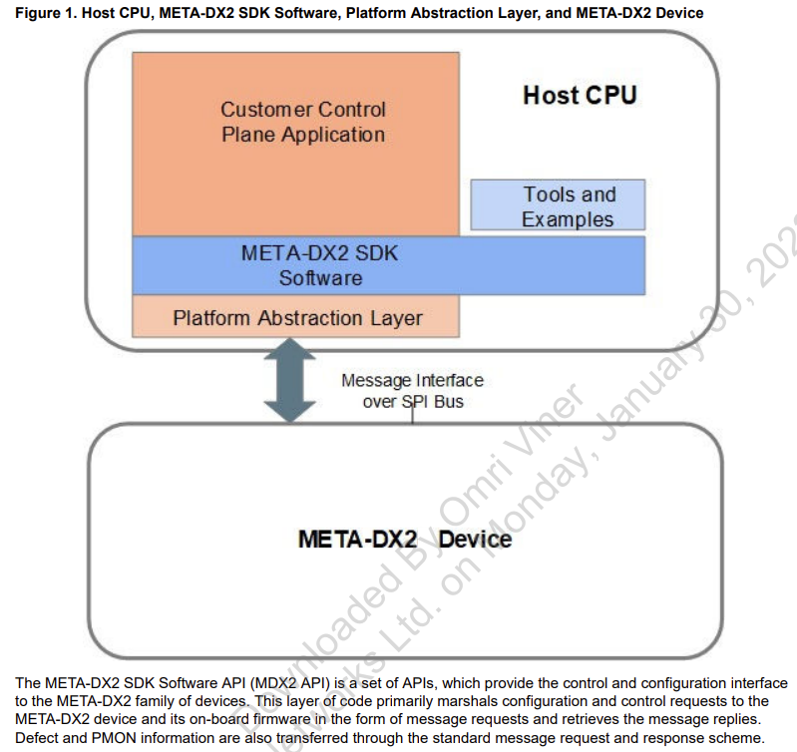
META-DX2+ SDK
There is SDK for META-DX2+ control
The META-DX2+ SDK provides a collection of high level APIs enabling a Customer Control Plane Application to configure and monitor device datapaths. The SDK provides C-language callable APIs, which communicate with firmware running on the META-DX2+ integrated CPU processor by means of a message interface over the SPI bus.
Note: To support Rev. C+ functions SDK 3.6.0+ have to be used

Slide 45
SDK possibilities for provisioning of datapaths
Prepare a datapath channel by a single function mdx2_chnl_prov (). Do it for client and host sides.
Gearbox and crosspoint parameters are defined in structure mdx2_chnl_cfg_t.
In the table is showed the SDK structure for control of this parameters.
Feature | SDK tool | Comment
Select of client or host SerDes | mdx2_chnl_cfg_t. serdes_pin_id | By default first serdes pin of the port, the full set of pins in the port are expanded using consecutive pins. If a custom configuration is require: 1. Use static configuration of SerDes map (see below) 2. MDX2_CHNL_FEATURE_CUSTOM_SERDES_LANES feature can be used to specify the list and order of SerDes pins for the port. Note: Using of MDX2_LINE_SERDES_ID(x) or MDX2_HOST_SERDES_ID(x) in this field activates ShiftIO mechanism automatically.
Determine of client or host port rate | mdx2_chnl_cfg_t. port_rate | Use mdx2_port_rate_t enumerator for determine a rate. Note: Using of MDX2_PORT_RATE_2x400GE_4_KP activates Lambda Split mechanism automatically. Reqiures additionally configuration of feature_mask and ext_cfg. See example
Determine of client and host datapath mode | mdx2_chnl_cfg_t. prov_mode | Use mdx2_chnl_prov_mode_t enumerator for determine a mode.
Example: mdx2_example_serdes.cpp, mdx2_example_retimer.cpp, mdx2_example_ls.cpp

Slide 46
Provisioning fields values
Allowed values of port rates and modes
mdx2_chnl_cfg_t.prov_mode
MDX2_PROV_MODE_ANALOG_RETIMER
MDX2_PROV_MODE_PCS_RETIMER
MDX2_PROV_MODE_MAC
mdx2_chnl_cfg_t.port_rate
Client side |  | Uplink side
MDX2_PORT_RATE_100GE |  | MDX2_PORT_RATE_100GE_1_KP
MDX2_PORT_RATE_100GE_4_KR |  | MDX2_PORT_RATE_400GE_4_KP
MDX2_PORT_RATE_100GE_2_KP |  | MDX2_PORT_RATE_IEEE_800GE_8_KP
MDX2_PORT_RATE_400GE_8_KP |  | MDX2_PORT_RATE_2x400GE_4_KP (for Lambda split)
MDX2_PORT_RATE_IEEE_800GE_8_KP
Note: When using a different number of lanes on the client and uplink sides, the gearbox is switched on automatically.

Slide 47
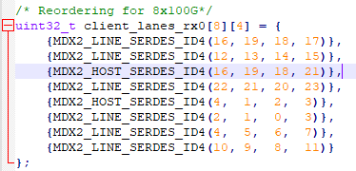
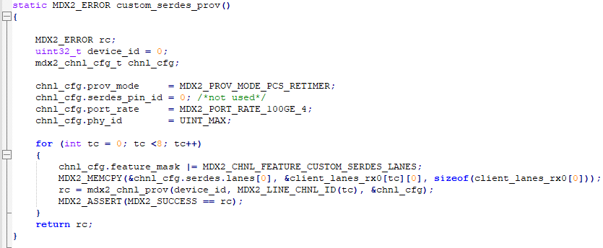
Static SerDes configuration map (customizing)
Physical line and host lane map. Lanes can be swapped/reodered based on the HW design.
Reordering is done by function mdx2_chnl_prov ()
MAC;
47

Slide 48
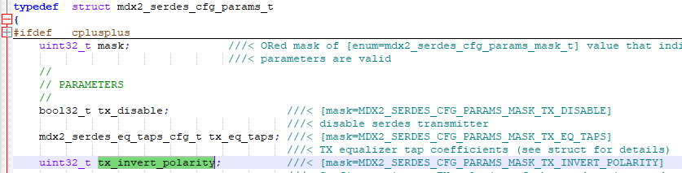
Lane customizing (Swap polarity)
There is the possibility to invert RX/TX polarity. Polarity is controlled by the mdx2_serdes_cfg_params_t structure. The order of SerDes and necessity of invert depends on PCB.
Function | Parameters | Comment
mdx2_serdes_chnl_cfg_params_set () | (const uint32_t device_id, const uint32_t chnl_id, const mdx2_serdes_cfg_params_t * params ) | Polarity swapping performs for provisioned channel.
Bit masks for inverting

Slide 49
Activate/deactivate datapath channel – connect host & line segments
To enable datapath channel is used connect function. All crossconnecting, gearboxing, retiming features defined in provisioning are activated automatically
To disable datapath channel is used disconnect function.
Function | Parameters | Comment
mdx2_connect | (const uint32_t device_id, const uint32_t chnl_id) | This function connects a host and line side datapath segment.
mdx2_disconnect | (const uint32_t device_id, const uint32_t chnl_id) | This function disconnects the line and host datapath. The connection would have been initially created with a call to mdx2_connect.

Slide 50
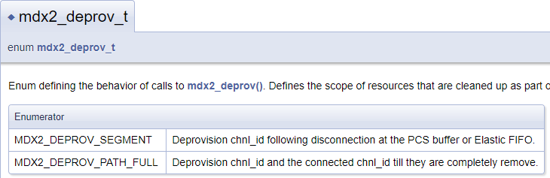
Datapath control - deprovisioning
API uses a channel identifier to de-provision a datapath segment. This API releases all assigned resources for the datapath and the channel identifier may be reused by the application for a new provisioning request. The resources freed (for example, SerDes pins or Ethernet PHY channels) are placed in reset.
If the channel has not been disconnected prior, that operation will be included within this request. The scope of de-provisioning may be by segment or full path, permitting an end-to-end path to be de-provisioned with a single API
Function | Parameters | Comment
mdx2_deprov | (const uint32_t device_id, const uint32_t chnl_id, const mdx2_deprov_t mode) | This function deprovisions a datapath. 1. The channel ID provided identifies which segment or path needs to be deleted. In the case of a channel provisioned for ANLT where the process has not completed, the function will terminate ANLT process. 2. Release provisioned ports (for host and line sides)

Slide 51
META-DX2+ control
The APIs are used for cold or warm device initialization before datapaths are provisioned. Once firmware download and device initialization is complete, the application can issue other API calls to the device. Firmware download may be performed in parallel to multiple devices through concurrent calls to mdx2_device_init(), provided there is a SPI bus per device. The firmware image is an uncompressed flat image that is directly copied to device memory and executed in place.
There is hitless firmware upgrade process. Function mdx2_device_init() can be used with MDX2_INIT_AUTO to reset and reload firmware which supports a firmware context conversion from one release to the next.
Firmware downgrade is not supported.

Slide 52
SDK functions for device initialization, shutdown, upgrade
Function | Parameters | Comment
mdx2_device_init | (const uint32_t device_id, mdx2_init_type_t init_type) | This function performs start up initialization of the underlying META-DX2 device and connection to it.
mdx2_device_uninit | (const uint32_t device_id, const bool8_t shutdown); | This function destroys the host information stored for device_id passed in. It will optionally reset device or leave running. When left running a warm restart operation and software/firmware upgrade can be performed.
mdx2_sdk_fw_filename_set | (const char *file_name) | Function sets the path from where the Firmware should be downloaded. This API is not device specific. This must be called before mdx2_device_init() to set the path for download, otherwise the default file (./mdx2_fw_app_reva.mem or ./mdx2_fw_app_revb.mem) will be selected based on the device revision. On setting the filename to 'path'/mdx2_fw_app_revx.mem, the revision ID will decide if RevA or RevB Firmware image to download.

Slide 53
Monitoring of device status
Function | Parameters | Comment
mdx2_device_status_get | (const uint32_t device_id, mdx2_status_info_t * status_ptr ) | Function retrieves device status information. Retrieves the current version and revision values. Build target information and the hardware revision. Host SW version is added locally to the status. All updates are added to the status_ptr reference parameter.
The function returns common information about META-DX2+ operation:
device_type
device_revision
device_temperature
device_info_8
device_info_9
fw_alive
fw_up_time
fw_is_configured
fw_revision
fw_version
PL-8000T shall use periodic checks of temperature and firmware status (polling method).

Slide 54
Performance Monitoring
In Monitoring part described functions for META-DX2 Plus family variant
Function | Parameters | Comment
mdx2_pmon_cfg_set | (const uint32_t device_id, const mdx2_pmon_cfg_t *cfg_ptr) | This function allows configuring runtime PMON collection mode for datapath counters.
mdx2p_pmon_pcs_get | (const uint32_t device_id, const uint32_t chnl_id, const bool32_t reset, mdx2p_pmon_pcs_t *pmon_ptr) | This function will retrieve the PCS PMONs for the specified chnl_id. This is the function that should be used for META-DX2 Plus family variant. (use device_variant from mdx2_status_info_t to get the family variant)
mdx2p_pmon_pcs_get () returns:
indicator of counters validity
Get of counters (ber, vlane_bip, fec_err_histogram, fec_good_cw, fec_corr_cw, fec_corr_0s_symb, fec_corr_1s_symb, fec_lane_symb_err, ber_elapsed_sec, ber_elapsed_usec, fc_fec_corr_cw, fc_fec_uncorr_cw, scramble_idle_cycle, scramble_err_idle, scramble_idle_pattern_count, line_code_violation, reframe)
PL-8000T shall monitor FEC and BER metrics. See section “Performance monitoring”.

Slide 55
DEFECTS processing
Hardware fault conditions and alarms are captured in device interrupt registers and retrieved through SDK APIs. The SDK refers to these as defects. Each individual defect is represented by a bitwise IVE (Interrupt, Value, Enable). The Value bit is the current state, whereas the Interrupt bit indicates a change in state and is latched until cleared. The Enable bit may be set to propagate the Interrupt to the INTB device interrupt pin. Firmware collects and organizes these IVEs into trees with summary nodes allowing for easier search of the entries with asserted Is or Vs. The application retrieves the IVE trees/collections using mdx2_defect xxx_get() APIs, which may be called in a polling method, or solely in response to the INTB interrupt, or a combination of both. These APIs synchronously retrieve the associated IVEs from device registers and optionally clear the asserted Interrupts.
PL-8000T shall handle interrupts from META-DX
For debug purposes may retrieve the defects by polling method.

Slide 56
DEFECTS processing (continue)
Common information about defects:
Function | Parameter | Comment
mdx2_defect_summary_get | (const uint32_t device_id, mdx2_defect_device_summary_t *defect_ptr) | This function returns the device summary defects identifying which channel(s) or other sources have interrupts set.
mdx2p_defect_phy_chnl_get | (const uint32_t device_id, const uint32_t chnl_id, const mdx2_defect_transfer_clear_t clear_type, mdx2p_defect_phy_chnl_t * defect_ptr) | This function returns the channelized PHY defects for the specified channel. The source defect Is may be optional cleared.
mdx2_defect_mac_get() | (const uint32_t device_id, const uint32_t chnl_id, const mdx2_defect_transfer_clear_t clear_type, mdx2_defect_mac_t * defect_ptr) | This function returns the channelized MAC port defects for the specified channel. The source defect Is may be optional cleared.

Slide 57
DEFECTS (continue)
mdx2p_defect_pcs_get() returns:
list of defects (dlos_sig, dlobl, dloam, dlol, skew_error, dhiser, timing_loss, link_fail, dfec_deg_ser, drx_am_sf_change, bip)
For deep debug may use follow functions:
mdx2p_defect_serdes_get() returns:
Set of defects (dlos, trained, sig_detect, timing, diag, pad - this is needed for the HTL/DTL to be word aligned)
57

Slide 58
Loopbacks (SDK functions)
// set all of the serdes pins in the port for facility loopback (TX source is RX)
serdes_params.mask = MDX2_SERDES_RUNTIME_PARAMS_MASK_TX_SRC;
serdes_params.tx_src = MDX2_SERDES_TX_SRC_LPBK;
rc = mdx2_serdes_chnl_runtime_params_set(device_id, chnl_id, &serdes_params);
Or set all of the serdes pins in the port for diagnostic loopback (RX source is TX)
serdes_params.mask = MDX2_SERDES_RUNTIME_PARAMS_MASK_RX_SRC;
serdes_params.tx_src = MDX2_SERDES_RX_SRC_LPBK;
rc = mdx2_serdes_chnl_runtime_params_set(device_id, chnl_id, &serdes_params);
There is possibility to loopback each SerDes separately
rc = mdx2_serdes_pin_runtime_params_set(device_id, serdes_pin_id_start, &serdes_params);
To restore normal operation:
serdes_params.tx_src = MDX2_SERDES_TX_SRC_DATA;
serdes_params.rx_src = MDX2_SERDES_RX_SRC_DATA;
Example: mdx2_example_serdes.cpp

Slide 59
PRBS (SDK functions)
// Setup the runtime call to enable the PRBS generator and monitor
mdx2_serdes_runtime_params_t serdes_params;
// set TX PRBS to be PRBS31
serdes_params.mask |= DX2_SERDES_RUNTIME_PARAMS_MASK_PRBS_GEN_CFG;
serdes_params.prbs_gen_cfg.prbs_mode = MDX2_SERDES_PRBS_NRZ_31;
// Enable the TX PRBS generator
serdes_params.mask |= MDX2_SERDES_RUNTIME_PARAMS_MASK_TX_SRC;
serdes_params.tx_src = MDX2_SERDES_TX_SRC_PRBS;
// Set PRBS monitor to be PRBS31
serdes_params.mask |= MDX2_SERDES_RUNTIME_PARAMS_MASK_PRBS_MON_CFG; serdes_params.prbs_mon_cfg.prbs_mode = MDX2_SERDES_PRBS_NRZ_31;
// Call PRBS api to enable the PRBS generator and monitor for all pins in a port.
// Setting the PRBS monitor to anything other than MDX2_SERDES_PRBS_DISABLED
// starts the monitor and resets the timer. The PRBS generator is started when
// the TX source is changed to MDX2_SERDES_TX_SRC_PRBS.
rc = mdx2_serdes_chnl_runtime_params_set(device_id, chnl_id, &serdes_params);

Slide 60
LLDP

Slide 61
The LLDP protocol
LLDP Ethernet frame structure
LLDP multicast address | Source MAC | Ether Type | TLV 1 | TLV 2 | TLV 3 | TLV n | End of LLDPDU TLV | Frame check sequence
01:80:C2:00:00:0E | SA | 0x88CC | Type=1 | Type=2 | Type=3 | Type X | Type=0
6 bytes | 6 bytes | 2 bytes | 1500 bytes |  |  |  |  | 4 bytes
The following fields are must have in LLDPDU:
Chassis ID TLV (Type = 1)
Port ID TLV (Type = 2)
Time To Live TLV (Type = 3)
End of LLDPDU TLV (Type = 0)
TLV structure
Type | Length | Value
7 bits | 9 bits | 0-511 octets
The optional fields are:
Port Description TLV (Type = 4)
System Name TLV (Type = 5)
System Description TLV (Type = 6)
System Capabilities TLV (Type = 7)
The LLDP information is sent by devices from each of their interfaces at a fixed interval, in the form of an Ethernet frame. Each frame contains one LLDP Data Unit (LLDPDU). Each LLDPDU is a sequence of type-length-value (TLV) structures.
The Ethernet frame used in LLDP typically has its destination MAC address set to a special multicast address that 802.1D-compliant bridges do not forward. Other multicast and unicast destination addresses are permitted. The EtherType field is set to 0x88cc.

Slide 62
Filter settings
META-DX2+ allows to capture 3 kinds of LLDP frames:
Filter A : Nearest Bridge (DA: 01-80-c2-00-00-0e)
Filter B : Nearest Customer Bridge (DA: 01-80-c2-00-00-00)
Filter C : Nearest non-TPMR Bridge (DA: 01-80-c2-00-00-03)
To capture LLDP frame, the following filter settings are necessary.
LLDP ETH Type
Destination MAC address

Slide 63
LLDP processing (SDK functions)
Function | Parameter | Comment
mdx2_moi_pkt_ext_chnl_rule_cfg_set | const uint32_t device_id, const uint32_t enet_chnl_id, const mdx2_moi_pkt_ext_chnl_rule_cfg_t * pkt_ext_chnl_rule_cfg) | This function configures parameters for packet extract rule of operation on an ENET channel.
mdx2_moi_chnl_prov | const uint32_t device_id, const uint32_t chnl_id, const mdx2_moi_chnl_cfg_t *cfg_ptr) | Configure MOI Channel including CPU path if necessary.
mdx2_moi_cpu_pkt_pop | (const uint32_t device_id, mdx2_moi_cpu_pkt_rx_desc_t *pkt_desc) | This function POP one packet to CPU.
mdx2_moi_cpu_pkt_read | (const uint32_t device_id, const uint32_t pkt_addr, uint32_t pkt_len, mdx2_moi_cpu_pkt_data_t * pkt_data) | This function reads from memory one CPU packet.

Slide 64
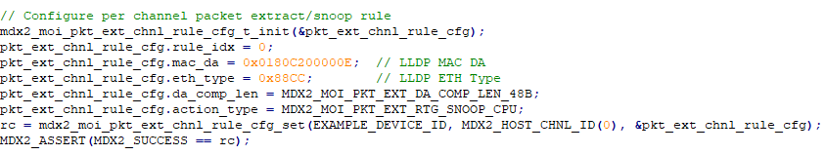
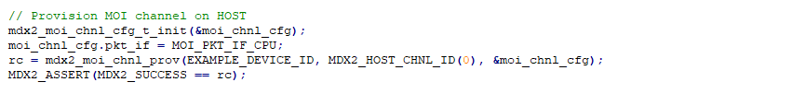
Acquisition control of LLDP frame
Procedure of LLDP frame acquisition
1. For monitored channel have to be set monitoring rule
Filter settings
2. Have to be activate monitoring channel
Monitored channel ID
3. Poll LLDP packet buffer
4. Read LLDP packets
Example: mdx2_example_lldp_snoop_cpu.cpp

Slide 65
LLDP-V2 MIB
By default LLDP is disabled lldpV2PortConfigAdminStatus=disabled(4)
Only LLDP Receive shall be supported lldpV2PortConfigAdminStatus= rxOnly(2)
Should populate the lldpV2RemTable table
The GUI Shall display the LLDP TAB for ETH services with the corresponding lldpV2RemTable entries.
Up to 3 entries may be shown for a local port
After TTL (Time To Live) expiration, the LLDP entry should be deleted from the MIB and from the GUI
lldpV2PortConfigTable Object | Type | Default | Comments
lldpV2PortConfigIfIndex | InterfaceIndex | N/A | The local port ifIndex
lldpV2PortConfigDestAddressIndex | LldpV2DestAddressTableIndex
lldpV2PortConfigAdminStatus | INTEGER | disabled(4) | GUI – LLDP Admin Status
lldpV2PortConfigNotificationEnable | TruthValue | False
lldpV2PortConfigTLVsTxEnable | BITS | 0

Slide 66
The lldpV2RemTable
Object | Type | Default | Comments
lldpV2RemTimeMark | TimeFilter | N/A
lldpV2RemLocalIfIndex | InterfaceIndex | N/A | Local port ifIndex
lldpV2RemLocalDestMACAddress | LldpV2DestAddressTableIndex | N/A | Should support up to 3 addresses
lldpV2RemIndex | Integer32 | Increment
lldpV2RemChassisIdSubtype | LldpV2ChassisIdSubtype | 0
lldpV2RemChassisId | LldpV2ChassisId |  | GUI – Remote Chassis ID
lldpV2RemPortIdSubtype | LldpV2PortIdSubtype
lldpV2RemPortId | LldpV2PortId |  | GUI – Remote Port ID
lldpV2RemPortDesc | SnmpAdminString |  | GUI – Remote Port Description
lldpV2RemSysName | SnmpAdminString |  | GUI – Remote System Name
lldpV2RemSysDesc | SnmpAdminString |  | GUI – Remote System Description
lldpV2RemSysCapSupported | LldpV2SystemCapabilitiesMap
lldpV2RemSysCapEnabled | LldpV2SystemCapabilitiesMap
lldpV2RemRemoteChanges | TruthValue
lldpV2RemTooManyNeighbors | TruthValue

Slide 67
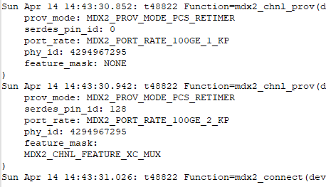
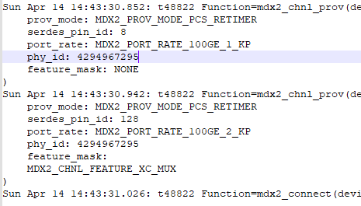
Protection – channel configuration
Stages for preparing protection channel configuration (mode Line to Host)
Create active connection
Provision LINE active channel (to first uplink)
Provision HOST channel with protection sign
(mask = MDX2_CHNL_FEATURE_XC_MUX)
Create standby connection
Provision LINE standby channel (to second uplink)
Provision HOST channel with protection sign
(mask = MDX2_CHNL_FEATURE_XC_MUX)
Example: mdx2_example_xc_mux.cpp
67

Slide 68
Protection – Crosspoint MUX 2:1 switching & monitoring
Software switching [mdx2_xc_mux_active_select_set()]
Get active channel [mdx2_xc_mux_active_select_get()]
Function | Parameters | Comment
mdx2_xc_mux_active_select_set | (const uint32_t device_id, const uint32_t chnl_id) | This function selects active channel for a 2:1 XC MUX datapath. To use, both channel must be provisioned with MDX2_CHNL_FEATURE_XC_MUX feature mask. The first channel provisioned with be the active channel, the second channel will be the standby channel. This API set the new active. Note, if the active channel is deprovisioned, the protect channel will automatically become the working channel.
mdx2_xc_mux_active_select_get | (const uint32_t device_id, const uint32_t chnl_id, uint32_t *actv_chnl_id_ptr) | This function gets active channel for a 2:1 XC MUX datapath from any channels used to build the datapath.
Example: mdx2_example_xc_mux.cpp
PL-8000T shall switch to active channel during processing interrupt from Uplink

Slide 69
Requirements for Uplink

Slide 70
Overview
Uplink Acacia C9 DP08SFP8 [5]
C9 DP08QSDD-ZRB / DP08QSDD-ZRS / DP08QSDD-ZRA family of QSFP-DD form factor coherent pluggable modules based on Modem Probabilistic Constellation Shaping (MPCS) DP-QPSK to DP-16QAM modulations, polarization diversity coherent Intradyne detection and advanced electronic link equalization. The Digital Coherent Module’s small size and low power make it an optimal choice for a wide range of DCI/Cloud, metro access/aggregation, wireless backhaul, and campus interconnect applications
Supports ZR, OpenZR+, FlexO, Flexgrid, LLDP, 100GE/400GE/800GE
Supports ETC and IEEE 802.3 800GE Ethernet
Uplink Coherent QSFPDD-DCO 800G
Coherent’s FTCE33x6R1PCL QSFP-DD Digital Coherent Optics (DCO) transceivers supports multi-rate coherent transmission for metro, regional, and data center interconnect applications. On the host side, the module can accommodate either a single IEEE 800GE Ethernet signal or multiple 400GE/200GE/100GE Ethernet signals (n = 1…8) [1] that are multiplexed onto a single line interface. On the line side, the module supports 800G, 600G, and 400G line interfaces using dual polarization 16QAM, 8QAM, or QPSK modulations at symbol rates from 60 GBd to 118 Gbd. Upon request, additional high-performance modes are available with Probabilistic Constellation Shaping to extend transmission reach even further.
Supports OpenZR+, OIF 800ZR, Flexgrid, LLDP, 100GE/400GE/800GE clients

Slide 71
Ethernet services (Acacia)
Clients
Ethernet
1x 800G
2x 400G
8x 100G
MIX
FlexO
8x FOIC1.1-RS
Network mode framing | Host Format | Payload Rate | Media Format | FEC | Modulation
FlexO-8e-MPCS131-NOS-E | 8 x 100GAUI-1 | 800G | OpenROADM compliance (FlexO-8e) | SD-FEC | MPCS
 | 2 x 400GAUI-4
 | 8 x 100GAUI-1
FlexO-8-MPCS131-NOS-E | 8xFOIC1.1-RS |  | FlexO-8
FlexO-4e-MPCS066-OS | 4 x 100GAUI-1/2 | 400G | OpenROADM compliance (FlexO-4e)
 | 1 x 400GAUI-4/8
FlexO-4-MPCS069-OS* | 4xFOIC1.1-RS |  | FlexO-4
* - TBD. We should choose the mode base on Ch. Space, ROSNR, etc…
71

Slide 72
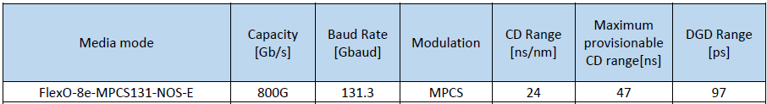
CD, OSNR, RX sensitivity and TX power
72
Line Framing | Payload | FEC_MODE | Modulation | NTWK Mode Framing | ROSNR sensitivity @ P1 RX power |  | ROSNR sensitivity @ P3 RX power |  | TX power - Typical [dBm] | TX power – Minimum [dBm]
 |  |  |  |  | P1 [dBm] | EOL ROSNR [dB] | P3 [dBm] | EOL ROSNR [dB]
FlexO-8e | 800G | SD-FEC | MPCS | FlexO-8e-MPCS131-NOS-E | -9 | 24.7 | -17 | 25.7 | 1.5 | 1
FlexO-8 |  |  |  | FlexO-8-MPCS131-NOS-E | -14 | 26.4 | -18 | 27.4
FlexO-4e | 400G |  |  | FlexO-4e-MPCS066-OS | -12 | 21.2 | -20 | 22.0
FlexO-4 |  |  |  | FlexO-4-MPCS069-OS-OS (TBD) | -14 | 21.5 | -20 | 22.5

Slide 73
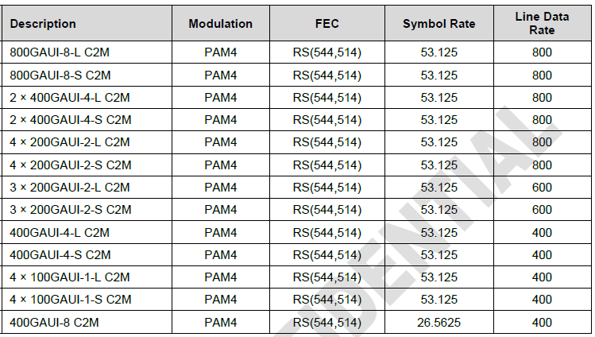
Ethernet (Coherent)
Clients
Ethernet
1x 800G
2x 400G
8x 100G
MIX TBD
73

Slide 74
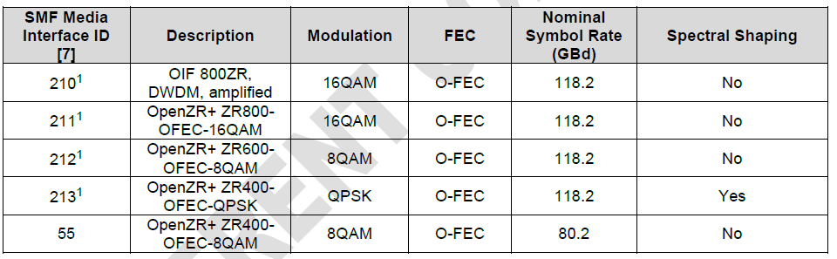
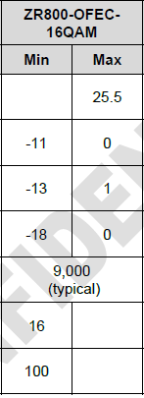
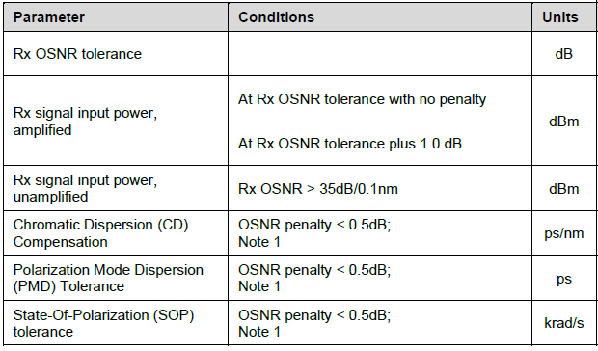
Uplink operation modes and parameters

Slide 75
GUI Configuration

Slide 76
GUI implementation (Main view)
Basic operations:
Lambda Split TBD:

Slide 77
Port enumeration and selection
Drop Down menu is used for numeration of client ports
This mode is implemented for 800G->8x100G breakout cable only

Slide 78
Uplink Port Configuration
Tab | Parameter | Values | MIB Objects | Comments
Uplink | Service Type/Speed | OpenZR+/FlexO | xpdrServiceType/ifHighSpeed (SL-XPDR-MIB, IF-MIB)
 | Modulation format | QAM16 | sfpConfigModulationFormat (SL-SFP-MIB)
 | Admin/Oper Status | Up/Down | ifAdminStatus/ifOperStatus (IF-MIB)
 | Inband Admin/Status | Enable/Disable | xpdrMuxInbandAdmin/xpdrMuxInbandOper (SL-XPDR-MIB)
 | Port alias | String | ifAlias (IF-MIB)

Slide 79
Uplink Port Configuration (continue)
Tab | Parameter | Values | MIB Objects | Comments
QSFPDD | Lanes spacing | 150G/Flex | sfpConfigCfpSpacing sfpConfigGridType (SL-SFP-MIB) | 150 - 150GHz spacing 6 - 6.25GHz spacing (flex grid)
 | Channel | Channel number | sfpConfigXfpDesiredFreq (SL-SFP-MIB) | For FixGrid should use 3 digit only* Not in use on FlexGrid
 | Wavelength | nm | sfpConfigWaveLength (SL-SFP-MIB) | Values should be calculated by formula: wl = (299792.458/Frequency) XXXX.XX (6 digit without dot) Note: In GUI we insert Frequency and calculate Wavelength
 | TX/RX Power Signal parameters | dBm | sfpDiagRxInputPower sfpDiagTxOutputPower
 | Temperature | Grad Celsius | sfpDiagModuleTemperature (SL-SFP-MIB)
 | TX Output Power Control | dB | sfpConfigVoaControl (SL-SFP-MIB) | The amount of attenuation set is given by the Byte value * 0.1 dB
 | RX VOA Target Power | dB | sfpConfigRxVoaControl | PL-8000T shall set the target RX VOA to -2dBm
 | RX High and Low Power Thresholds | dB | sfpDiagHighRxPowerAlmThreshold sfpDiagLowRxPowerAlmThreshold
* - sfpConfigXfpDesiredFreq Values
Frequency | Value
191.37500 | 137
191.52500 | 152
191.67500 | 167
191.82500 | 182
191.97500 | 197
192.12500 | 212
192.27500 | 227
192.42500 | 242
Frequency | Value
193.77500 | 377
193.92500 | 392
194.07500 | 407
194.22500 | 422
194.37500 | 437
194.52500 | 452
194.67500 | 467
194.82500 | 482
Frequency | Value
192.57500 | 257
192.72500 | 272
192.87500 | 287
193.02500 | 302
193.17500 | 317
193.32500 | 332
193.47500 | 347
193.62500 | 362
Frequency | Value
194.97500 | 497
195.12500 | 512
195.27500 | 527
195.42500 | 542
195.57500 | 557
195.72500 | 572
195.87500 | 587
196.02500 | 602

Slide 80
Service Port configuration (#1)
Tab | Parameter | Values | MIB Objects | Comments
Ports: Basic operation: 1..48* | Service Type/Speed | 800Gbe-LAN 400Gbe-LAN 2x400Gbe-LAN breakout 8x100Gbe-LAN breakout | xpdrServiceType/ifHighSpeed (SL-XPDR-MIB, IF-MIB) | * - List of ports for each Service Type see on the Slide 96
 |  | 800Gbe-LAN
Lambda split: 1,9,25,33
 | Loss Propagation | Enable/Disable | xpdrConnConfigLosPropagation
 | FEC Mode | Enable/Disable | xpdrFecMode | Disable FEC is allowed for 100G only
 | Admin/Oper Status | Up/Down | ifAdminStatus/ifOperStatus
QSFPDD | RX/TX Power |  | sfpDiagRxInputPower / sfpDiagTxOutputPower
 | Wavelength |  | sfpConfigWaveLength
 | Low/High Threshold |  | sfpDiagLowRxPowerAlmThreshold sfpDiagHighRxPowerAlmThreshold
 | Temperature |  | sfpDiagModuleTemperature
 | Vendor |  | sfpConfigVendorName
 | Module Type | QSFPDD | sfpConfigXcvrId
 | Lanes # | 8 | sfpConfigCfpSupportedLanes
 | PN/SN |  | sfpConfigVendorPN/sfpConfigVendorSN
 | Alias | String | ifAlias

Slide 81
Service Port configuration (#2)
Tab | Parameter | Values | MIB Objects | Comments
Ports: 9,21,33,45 | Service Type/Speed | 400Gbe-LAN 4x100Gbe-LAN breakout | xpdrServiceType/ifHighSpeed (SL-XPDR-MIB, IF-MIB) | For 4*FOIC1.2 shall use flexo4x100G
 | Loss Propagation | Enable/Disable | xpdrConnConfigLosPropagation
 | FEC Mode | Enable/Disable | xpdrFecMode | Disable FEC is allowed for 100G only
 | Admin/Oper Status | Up/Down | ifAdminStatus/ifOperStatus
QSFPDD | RX/TX Power |  | sfpDiagRxInputPower / sfpDiagTxOutputPower
 | Wavelength |  | sfpConfigWaveLength
 | Low/High Threshold |  | sfpDiagLowRxPowerAlmThreshold sfpDiagHighRxPowerAlmThreshold
 | Temperature |  | sfpDiagModuleTemperature
 | Vendor |  | sfpConfigVendorName
 | Module Type | QSFPDD | sfpConfigXcvrId
 | Lanes # | 8 | sfpConfigCfpSupportedLanes
 | PN/SN |  | sfpConfigVendorPN/sfpConfigVendorSN
 | Alias | String | ifAlias

Slide 82
Service Port configuration (#3)
Tab | Parameter | Values | MIB Objects | Comments
Ports: 1-48 | Service Type/Speed | 100Gbe-LAN | xpdrServiceType/ifHighSpeed (SL-XPDR-MIB, IF-MIB)
 | Loss Propagation | Enable/Disable | xpdrConnConfigLosPropagation
 | FEC Mode | Enable/Disable | xpdrFecMode
 | Admin/Oper Status | Up/Down | ifAdminStatus/ifOperStatus
QSFPDD | RX/TX Power |  | sfpDiagRxInputPower / sfpDiagTxOutputPower
 | Wavelength |  | sfpConfigWaveLength
 | Low/High Threshold |  | sfpDiagLowRxPowerAlmThreshold sfpDiagHighRxPowerAlmThreshold
 | Temperature |  | sfpDiagModuleTemperature
 | Vendor |  | sfpConfigVendorName
 | Module Type | QSFPDD | sfpConfigXcvrId
 | Lanes # | 4/8 ??????? | sfpConfigCfpSupportedLanes
 | PN/SN |  | sfpConfigVendorPN/sfpConfigVendorSN
 | Alias | String | ifAlias

Slide 83
Additional Requirements
 | Function | Comment
1 | Idle Insertion for Ethernet | Implemented by Uplink
2 | Inband OSC
3 | Dying Gasp
83

Slide 84
Performance Monitoring

Slide 85
Uplink PM
PM Type | Values | PM source | MIBs
Optical level | RX/TX Level OSNR & CD | QSFPDD-DCO | ifType=196; Path=0; CVs=RX, ESs=TX, SESs=OSNR, UASs=CD ifType=196; Path=2; CVs=High RX pwr, ESs=Low RX pwr, SESs=High TX pwr, SEFSs=Low TX pwr ifType=196; path=3; CVs=Max OSNR, ESs=Min OSNR ifType=196; path=4; CVs=Max CD, ESs=Min CD ifType=196; Path=1; Pre-FEC BER (CVs=Mantissa, ESs=Exponent)
SD-FEC Corr/Uncorr FEC Error ratio | Number of FEC Errors Ratio | QSFPDD-DCO | ifType=195; Path=5/6 ifType=195; Path=0; slOTNCurrentPmFecCerMant, slOTNCurrentPmFecCerExp*
CRC Errors |  | QSFPDD-DCO Maybe not supported for some Uplinks | ifType=196; Path=1; SESs=CRC
* - SL-OTN.mib, slOTNCurrentPmTable

Slide 86
Services PM
PM Type | Values | PM source (API functions) | Comments
100Gbe-LAN without FEC
Optical level | RX/TX Level | Get from client module via MSA
Native Signal | 64B/66B coding violation errors * | META-DX mdx2p_pmon_pcs_get() | Struct mdx2p_pmon_phy_rx_t ber (Number of 66b block received sync header errors)
Layer 2 PM | RX/TX bytes/RX/TX packets/RX/TX bad packets | META-DX mdx2_pmon_mac_get() | struct mdx2_pmon_mac_rx_t rx_octets_good/rx_pkts_good/rx_pkts_err tx_octets_good/tx_pkts_good/tx_pkts_err
100Gbe-LAN with FEC / 400Gbe-LAN / 800Gbe-LAN
Optical level | RX/TX Level | Get from client module via MSA
Native Signal | 64B/66B coding violation errors * | Same 100Gbe-LAN without FEC
Layer 2 PM | RX/TX bytes/RX/TX packets/RX/TX bad packets | Same 100Gbe-LAN without FEC
FEC Corr/Uncorr | Number of FEC Errors * | META-DX mdx2p_pmon_pcs_get() | Struct mdx2p_pmon_phy_rx_t fec_corr_cw, fec_err_histogram
FEC Error ratio | Ratio
FOIC 1.2
Optical level | RX/TX Level | Get from client module via MSA
FEC Corr/Uncorr | Number of FEC Errors * | QSFPDD-DCO
FEC Error ratio | Ratio | QSFPDD-DCO
* - Errors, Err Seconds, Severity Errored Seconds, Unavailable Seconds

Slide 87
Faults

Slide 88
PL-8000T Faults – General Requirements
Alarms:
800G QSFPDD-DCO module alarms
Line OTN alarms for uplinks
100GbE/400GE/800GE/FOIC1.2 alarms for clients
Encryption alarms
System alarms
FAN and PSU alarms
EDFA and Optical Switch alarms
Events:
Alarm Rise/Clear
Configuration Change
Inventory Change
Asynchronous event
Warm/Cold boot to the system
Admin Up/Down to port
Protection Switching
The last 512 events are kept in a cyclic buffer

Slide 89
Line Alarms Hierarchy
Optics Removed
Optics
LOS
HW Failure
High/Low Temp
High/Low Rx Power
Bit rate Mismatch
Loss of Lock
pN_EBC
LOS
LOF/LOM
OpenZR+/FlexO
RPF
HI-BER

Slide 90
PL-8000T Uplink Alarms
Layer | Alarm | LED | Severity | Mib Object | Masking Alarms | Comments
Optics | Optics Removed | Yes | Critical | sfpRemoved(702) | None | Optical module is missing
 | Bit rate Mismatch | Yes | Critical | sfpBitRateMismatch(704) | Optics Removed | Optical module rate mismatch
 | LOS | Yes | Critical | sfpLossOfLight(707) | Optics Removed | Loss of signal
 | Loss of Lock (LOL) | Yes | Critical | sfpLossOfLock(705) | LOS; Optics removed | CDR unlocked
 | HW failure | Yes | Critical | sfpTransmitFault(701) | Optics Removed | Laser Temperature High Alarm
 |  |  |  |  |  | Power Supply Fault
 |  | Yes | Critical
 | High temp | Yes | Critical | sfpHighTemp(720) | Optics Removed | Optics high temperature
 | Low Temp | Yes | Critical | sfpLowTemp(721) | Optics Removed | Optics low temperature
 | High Rx Power | Yes | Critical | sfpHighRxPower(728) | Optics Removed | High Rx power
 | Low Rx Power | Yes | Critical | sfpLowRxPower(729) | Optics Removed | Low Rx power
Misc | Inband Failure | No | Critical | muxInbandFail(454) | None | The in-band channel has failed
 | Key Exchange Failed | Yes | Critical | encKeyExchangeFailed(223) | None | Key Exchange failed for uplink

Slide 91
PL-8000T Uplink Alarms (continue) TBD. Double check
Layer | Alarm | LED | Severity | Mib Object | Masking Alarms | Comments
ZR+/ FlexO | LOS | Yes | Critical | otnLos(754) | None | Loss of signal
 | LOF/LOM | Yes | Critical | otnLof(755) | LOS | loss of frame/multiframe
 | HI-BER | Yes | Minor | sf(10) | LOS; LOF | Section and HO Path 1E-06 errors
 | RPF | Yes | Minor | flexORpf(952) | LOS; LOF
Notes:
All port alarms are masked by Admin Down to the port
If the remote side has a Loss of Light, loss of Lock or Loss of Sync, the local Client port shall present the RPF (Remote PHY Fault) alarm

Slide 92
Ethernet Client Alarms Hierarchy
Optics Removed
Optics
Alarms
LOS
HW Failure
High/Low Temp
High/Low Rx Power
Bit rate Mismatch
Loss of Lock
Data
Client
Alarms
Loss of Sync
LF
HI-BER

Slide 93
FOIC Client Alarms Hierarchy
Optics Removed
Optics
Alarms
LOS
HW Failure
High/Low Temp
High/Low Rx Power
Bit rate Mismatch
Loss of Lock
Data
Client
Alarms
LOF/LOM
RPF
HI-BER

Slide 94
PL-8000T Client Alarm Scheme
Layer | Alarm | LED | Severity | Mib Object | Masking Alarms | Comments | Source
Optics (for all clients) | Optics Removed | Yes | Critical | sfpRemoved(702) | None | Optical module is missing | PL-8000T chassis
 | Bit rate Mismatch | Yes | Critical | sfpBitRateMismatch(704) | Optics Removed | Optical module rate mismatch | Client module
 | LOS | Yes | Critical | sfpLossOfLight(707) | Optics Removed | Optical loss of signal | Client module
 | Loss of Lock (LOL) | Yes | Critical | sfpLossOfLock(705) | LOS; Optics removed | CDR unlocked | Client module
 | HW failure | Yes | Critical | sfpTransmitFault(701) | Optics Removed | Optics hardware failure | Client module
 | High/Low temp | Yes | Critical | sfpHigh/LowTemp(720/721) | Optics Removed | Optical Module High/Low Temp | Client module
 | High/Low Rx Power | Yes | Critical | sfpHigh/LowRxPower(728/729) | Optics Removed | Optical Module High/Low Rx Pw | Client module
100G/ 400G/ 800G ETH | Loss of Sync | Yes | Critical | ethConfigPcsLossSync(204) | None | 64b/66b | META-DX struct mdx2p_defect_phy_chnl_t. pcs_status // dlos_sync = not pcs_status See mdx2_defect_pcs.h
 | LF | Yes | Critical | ethConfigLinkFail(203) | Loss of Sync | Local Fault | META-DX struct mdx2_defect_mac_chnl_t.drdi (dfdi)
 | RF | No | Minor | ethConfigTransmitFault(201) | Loss of Sync | Remote Fault
 | HI-BER | Yes | Minor | sf(10) | Loss of Sync | PCS 1E-06 errors | META-DX struct mdx2p_defect_phy_chnl_t.dhiber_hiser
FOIC1.2 | LOFLOM | Yes | Critical | flexOLof(950)/flexOLom(951) | None |  | Uplink
 | HI-BER | Yes | Minor | sf(10) | LOFLOM | Raised by CRC and Uncorr FEC | Uplink
 | RPF | Yes | Minor | flexORpf(952) | LOFLOM | Remote PHY Fault | Uplink

Slide 95
PL-8000T Ethernet Alarm Structure
RPF
LOS/LOL
ETH RF
ETH Loss of Sync
Encryption
Alarm
ETH LF
ETH Alarm
Encryption Fail
ETH HIBER
LOF/LOM
Line Alarm
LOS
LOS
ETH RF
RPF Alarm
RPF
CRC (if supported by uplink)
ETH LF
HIBER Alarm
With LOS Propagation
FEC Uncorr
Without LOS Propagation
Ethernet Client
OpenZR+ Line
TBD: Propagation for Encryption fault.
Depend on implementation MACSec
in META-DX
Defect
Detection
Defect
Generation
Alarm
Generation

Slide 96
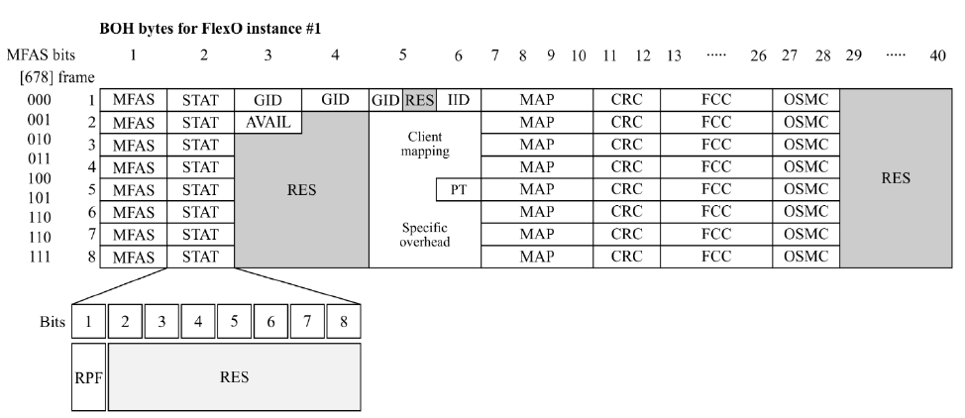
PL-8000T FlexO Alarm Structure
FlexO Client
FlexO Line
LOS Defect
Client Alarm
LOF/LOM Defect
RPF
CRC errors
HIBER Alarm
FEC Uncorr
LOF/LOM Defect
RPF Alarm
Line Alarm
LOS Defect
RPF (Remote PHY Fault) - indicator of Remote Fault in the FlexO structure
RPF
LOS
HIBER Alarm
CRC errors
With LOS Propagation
FEC Uncorr
Without LOS Propagation
Detect
Detection
Defect
Generation
TBD:
Should be updated PL-4000M to send and receive RPF?
In this case RPF should translate to client.
Open Issue.

Slide 97
MIBs
Requirements

Slide 98
SEEP Changes
Address | Command | Type | Size [bytes] | MIB object | Value
0x02 | pr | char | 4 | sysObjectID | 8KT
0x08 | pt | char | 1 | slmOpticalSwitchExist | 0 – no OSW 1 – OSW exists 2 – OLP exists
0x0A | of | uint16 | 2 |  | Option flags Bit 0 - 0, or 1 for non-encryption model Bit 1 – 0, or 1 for disable super-user
0x5A | en | Uint8 | 1 | slmEdfaNumber | Number of the EDFA modules 0, 1 or 2

Slide 99
MIB Changes (Double check)
The following objects shall be changed to the mib:
sysObjectID: to add pl8000t = 1.3.6.1.4.1.4515.100.1.3000.2
MIB | Object | Changes
SL-XPDR | XpdrServiceType | Add types mix2x400GBEbreak mix2x4x100GBEbreak

Slide 100
ifTable

Slide 101
PL-8000T ifTable #1
System mode: Basic operation
Interface | Slot | Port | ifType | Path | Mibs | Index
Uplinks | 0 | 230,231,234,235 | 196 | 0 | IF-MIB | IfIndex
QSFPDD | 0 | 230,231,234,235, | 196 | 0 | SL-SFP | sfpConfigInterface
Optical PM | 0 | 230,231,234,235 | 196 | 0 | IF-MIB, SL-PM | ifIndex
OpenZR+/FlexO PM | 0 | 230,231,234,235 | 195 | 5-6 – fec corr/uncorr | IF-MIB, SL-PM | ifIndex
800GE Service | 0 | 1,13,25,37 | 196 | 0 | IF-MIB | IfIndex
QSFPDD | 0 | 1,9,13,21,25,33,37,45 | 196 | 0..8 | SL-SFP | sfpConfigInterface
400GE Service | 0 | 1,5,9,13,17,21,25,29,33,37,41,45 | 196 | 0 | IF-MIB | IfIndex
400G FlexO Service | 0 | 1,9,13,21,25,33,37,45 | 196 | 0 | IF-MIB | IfIndex
100G Service | 0 | 1..48 | 196 | 0 | IF-MIB | IfIndex
Optical PM | 0 | 1,9,13,21,25,33,37,45 | 196 | 0 | IF-MIB,SL-PM | ifIndex
800GbE PM | 0 | 1,13,25,37 | 6 | 0 – pcs errors 5-6 – fec corr/uncorr | IF-MIB, SL-PM | IfIndex
400GbE PM | 0 | 1,5,9,13,17,21,25,29,33,37,41,45 | 6 | 0 – pcs errors 5-6 – fec corr/uncorr | IF-MIB, SL-PM | IfIndex
100GbE PM | 0 | 1..48 | 6 | 0 – pcs errors 5-6 – fec corr/uncorr | IF-MIB, SL-PM | IfIndex
400G FlexO PM | 0 | 1,9,13,21,25,33,37,45 | 6 | 0 – pcs errors 5-6 – fec corr/uncorr | IF-MIB, SL-PM | IfIndex

Slide 102
PL-8000T ifTable #1
System mode: Lambda split
Interface | Slot | Port | ifType | Path | Mibs | Index
Uplinks | 0 | 230,231, 232,233, 234,235, 236,237 | 196 | 0 | IF-MIB | IfIndex
QSFPDD | 0 | 230,231, 232,233, 234,235, 236,237 | 196 | 0 | SL-SFP | sfpConfigInterface
Optical PM | 0 | 230,231,232,233, 234,235,236,237 | 196 | 0 | IF-MIB, SL-PM | ifIndex
OpenZR+ PM | 0 | 230,231,232,233, 234,235,236,237 | 195 | 5-6 – fec corr/uncorr | IF-MIB, SL-PM | ifIndex
800GE Service | 0 | 1,9,25,33 | 196 | 0 | IF-MIB | IfIndex
QSFPDD | 0 | 1,9,25,33 | 196 | 0..4 | SL-SFP | sfpConfigInterface
Optical PM | 0 | 1,9,25,33 | 196 | 0 | IF-MIB,SL-PM | ifIndex
800GbE PM | 0 | 1,9,25,33 | 6 | 0 – pcs errors 5-6 – fec corr/uncorr | IF-MIB, SL-PM | IfIndex

Slide 103
PL-8000T ifTable #2
Interface | Slot | Port | ifType | Path | Mibs | Index
EDFA 1-2 | 0 | 208..209 | 195 | 0 | SL-EDFA | edfaIndex
EDFA Optical PM | 0 | 208..209 | 195 | 0 | IF-MIB,SL-PM | ifIndex
MUX | 0 | 206..207 | 195 | 0 | SL-MUX | muxIfIndex
OSW with one degree requires 3 ports OLP – OSW with 4 degrees requires 9 additional ports | 0 | 210,211, 218 | 195 | 0 | IF-MIB, SL-PM SL-OSW SL-APS | ifIndex, slOSWPortConfigLineIndex ConfigUserWorkingIndex
 |  | 219..221
 |  | 222..224
 |  | 225...227
MNG | 0 | 117..118 | 196 | 0 | IF-MIB, SL-PM | ifIndex
MNG | 0 | 117..118 | 196 | 0 | SL-SFP | sfpConfigInterface
LAN | 0 | 101,103 | 6 | 0 | IF-MIB | ifIndex
Software Loopback | 0 | 101 | 24 | 0 | IF-MIB | ifIndex
RS232 | 0 | 102 | 33 | 0 | IF-MIB | ifIndex

Slide 104
Protection

Slide 105
Facility Protection: When an Optical Switch module is installed, facility protection is automatically applied to the COM ports. Equipment Protection: For equipment protection, redundant PL-8000T devices are required at both the local site and the remote site. At each site, one device is used as the Working device and the other is used as the Protection device. Ring Protection: Ring may provide protection for each service independently. Ring supports by PHY META-DX2+ (TBD) Only one type of protection can applied to the device
Types of protection

Slide 106
Ring protection (TBD)
PL-8000T supports two independent rings on uplinks U1, U2 and U3, U4
Ring created by consequently connections U1 -> U2 (U3 -> U4) for nodes A, B, C…
Any Ethernet service may be protected
On each node service have to be configured as AddDrop or Bypass
This rules should be enforced by Lightwatch

Slide 107
Ring protection (TBD)
Mirror symmetrical layout
Uplink 1 node A connect to Uplink 2 node B
Uplink 2 node A connect to Uplink 1 node B
Uplink 3 node A connect to Uplink 4 node B
Uplink 4 node A connect to Uplink 3 node B
Green is protected services
Node A:
C2 working – U1
C2 protection – U2
Node B:
U2 – C2 working
U1 – C2 protection
Blue is non-protected services
Node A:
C1 – U1
C5 – U3
Node B:
U2 – C1
U1 – C7
Advantages: Same port numeration on both sides
Disadvantages:
Difficult for implementation. Have to be implemented provisioning of services
TBD: Does need this complex provisioning?
PL-8000T shall use this configuration. This rules should be enforced by Lightwatch

Slide 108
Example of Ethernet protection (Add-Drop only)
Any Ethernet services (PCS retiming) on any ports may be protect by Crosspoint 2:1 MUX

Slide 109
Example of Ethernet protection (Add-Drop + Bypass)
Any Ethernet services (PCS retiming) on any port may be protect by Crosspoint 2:1 MUX
Bypass services (Analog retiming) can be provision simultaneously

Slide 110
Example of 4xFOIC1.2 protection (Add-Drop + Bypass)
In case of provisioning of Bypass (Analog retiming) for FOIC protection can be used C1 and C2 ports only
FOIC1.2 services (Analog retiming) on the ports C1 and C2 may be protect by Crosspoint 2:1 MUX
Limitation: PL-8000T shall use ports C1 and C2 to protect FOIC services.

Slide 111
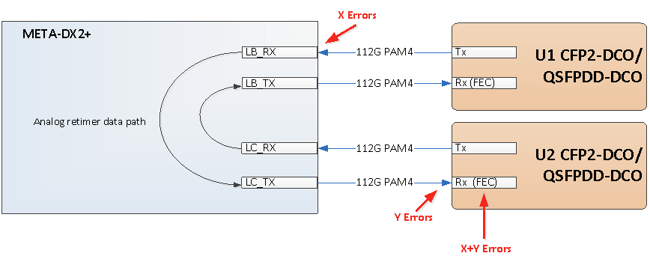
Analog bypass: potential issue
The path from one uplink to another has two spans of PAM4. If we using analog retiming for bypass we don't recalculate FEC. It is very stressful situation for 112G lanes. Errors are accumulated
Solution:
As a reserve variant may be used Same Side Connectivity through Ethernet slice (blue line):
It allows to recalculate FEC and correct errors after each span
Required double capacity of Ethernet channel (e.g. 100G bypass takes two 100G channels in Ethernet slice)
Not applicable for FOIC datapathes

Slide 112
Variants of facility protection implementation
Basic operation
Lambda Split*
OLP + splitter. Allow to switch RX interface; TX splits to Work and Protection fiber. Each side selects the Active line independently (Unidirectional).
OSW Allows to switch RX interface. TX splits to Work and Protection fiber. Uses internal MUXes. EDFAs are optional. Both side select the Active line independently (Unidirectional)
* - TBD: Check fit of MUXes : See slide 8. Open Issue

Slide 113
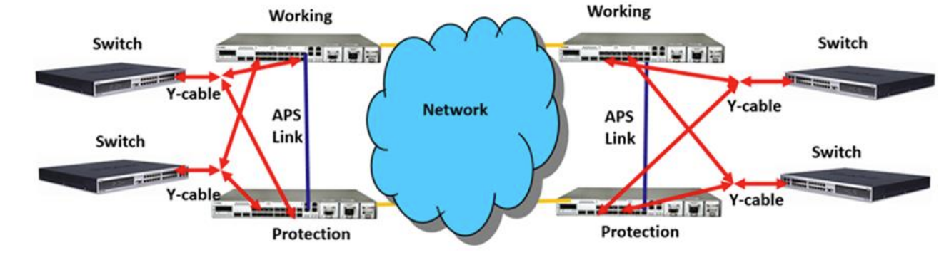
Equipment protection
For equipment protection, redundant PL-8000T devices are required at both the local site and the remote site. At each site, one device is used as the Working device and the other is used as the Protection device. In this configuration, automatic protection switching can be defined per service port. The protected service ports in the two devices should be connected to the client via Y-cable.

Slide 114
Open Issues
“Lambda Split” and “Basic operation”. Are these System mode for device or modes of Uplinks?
Using internal MUX/DEMUX for Lambda Splitting scheme
Ring protection architecture. Provisioning is to complicate
MACSec Encryption

Slide 116
GUI implementation
(Main view)
Ports C1,C3,C11,C13 – QSFPDD-800/400
Ports C2,C4,C12,C14 – QSFPDD-400
Ports C5..C10,C55..C60 –QSFP28

Slide 117
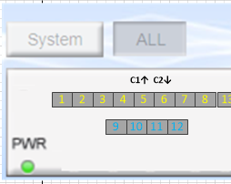
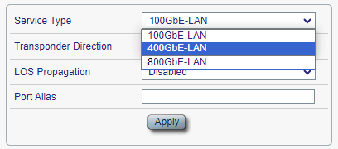
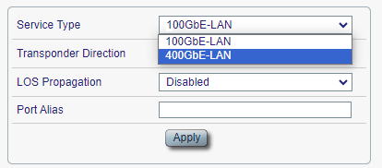
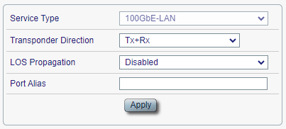
GUI implementation. (continue)
Only first port in group allows to select Service type. The rest ports obtain the same type automatically.
First port allow to choose port mode
Other ports don’t allow to choose port mode

Slide 118
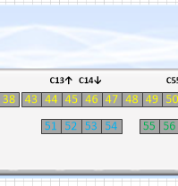
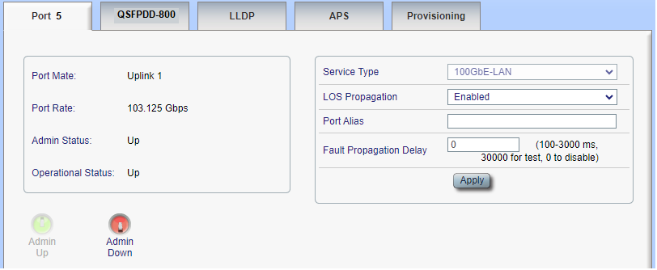
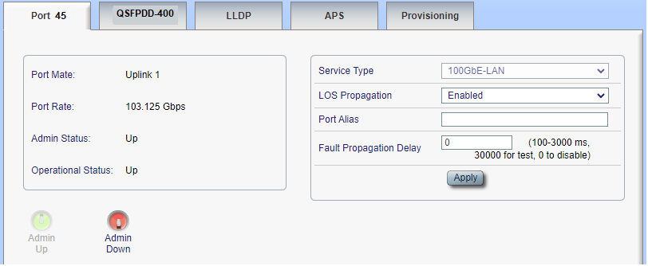
GUI implementation (Choosing of Ports)
The client port C1, service number 5
The client port C14, service number 52
Port 52

Slide 119
Example of 4xFOIC1.2 protection (Add-Drop + Bypass)
In case of provisioning of Bypass (Analog retiming) for FOIC protection can be used C3 and C4 ports only
FOIC1.2 services (Analog retiming) on the ports C3 and C4 may be protect by Crosspoint 2:1 MUX
Limitation: PL-8000T shall use ports C3 and C4 to protect FOIC services.

Slide 120
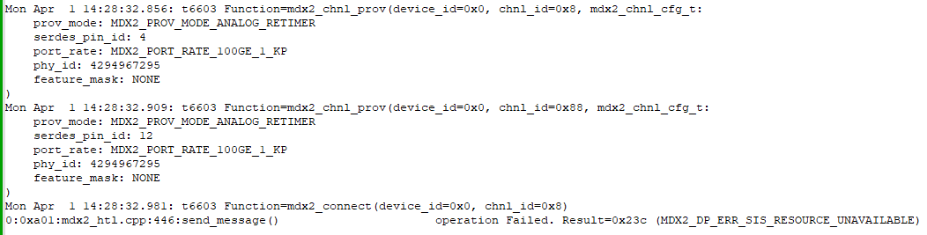
AddDrop + Bypass Issue
Simulator SDK 3.2.0
Function mdx2_connect returns error in case of simultaneously provisioning protection AddDrop and Bypass services (see log).
Result is not depend on client port (C1-C4)
TDB: It requires to research with Microchip
Should check SDK 3.5.0

